Slide 1

WIN-WIN-WIN APPROACHES
TO ACCOUNTABLE CARE
Better Ways to Pay for and
Deliver Health Care
Harold D. Miller
President and CEO
Center for Healthcare Quality and Payment Reform
www.CHQPR.org

Slide 2
I have no commercial relationships, other than participating in October 2015 on a one-time advisory committee for Pfizer regarding the future of vaccines.

Slide 3
How Do You Control Growing Healthcare Spending?
$
TOTAL
HEALTH
CARE
SPENDING
TOTAL
HEALTH
CARE
SPENDING
TOTAL
HEALTH
CARE
SPENDING
TOTAL
HEALTH
CARE
SPENDING
TIME

Slide 4
Typical Strategy #1:
Cut Provider Fees for Services
$
SAVINGS
TOTAL
HEALTH
CARE
SPENDING
Cut
Provider Fees
TOTAL
HEALTH
CARE
SPENDING
TOTAL
HEALTH
CARE
SPENDING
BY
PAYERS
TOTAL
HEALTH
CARE
SPENDING

Slide 5
Typical Strategy #2:
Shift Costs to Patients
$
SAVINGS
TOTAL
HEALTH
CARE
SPENDING
TOTAL
HEALTH
CARE
SPENDING
TOTAL
HEALTH
CARE
SPENDING
TOTAL
HEALTH
CARE
SPENDING
BY
PAYERS
Higher
Cost-Share &
Deductibles

Slide 6
Results of the Typical Strategies
Consolidation of providers to resist cuts in fees
Shifts in care to higher-cost settings
Increases in utilization to offset losses in revenue
Patients avoiding necessary care due to high cost-sharing
Large increases in health insurance premiums
Inability to afford health insurance

Slide 7
Results of the Typical Strategies
Consolidation of providers to resist cuts in fees
Shifts in care to higher-cost settings
Increases in utilization to offset losses in revenue
Patients avoiding necessary care due to high cost-sharing
Large increases in health insurance premiums
Inability to afford health insurance
IS THERE A BETTER WAY?

Slide 8
The Right Focus: Spending
That is Unnecessary or Avoidable
$
AVOIDABLE
SPENDING
AVOIDABLE
SPENDING
AVOIDABLE
SPENDING
AVOIDABLE
SPENDING
NECESSARY
SPENDING
NECESSARY
SPENDING
NECESSARY
SPENDING
NECESSARY
SPENDING
TIME

Slide 9
Avoidable Spending Occurs
In All Aspects of Healthcare
$
AVOIDABLE
SPENDING
NECESSARY
SPENDING

Slide 10
Avoidable Spending Occurs
In All Aspects of Healthcare
SURGERY
Unnecessary surgery
Use of unnecessarily-expensive implants
Infections and complications of surgery
Overuse of inpatient rehabilitation
$
AVOIDABLE
SPENDING
NECESSARY
SPENDING

Slide 11
Avoidable Spending Occurs
In All Aspects of Healthcare
SURGERY
Unnecessary surgery
Use of unnecessarily-expensive implants
Infections and complications of surgery
Overuse of inpatient rehabilitation
$
AVOIDABLE
SPENDING
CANCER TREATMENT
Use of unnecessarily-expensive drugs
ER visits/hospital stays for dehydration and avoidable complications
Fruitless treatment at end of life
Late-stage cancers due to poor screening
NECESSARY
SPENDING

Slide 12
Avoidable Spending Occurs
In All Aspects of Healthcare
SURGERY
Unnecessary surgery
Use of unnecessarily-expensive implants
Infections and complications of surgery
Overuse of inpatient rehabilitation
$
AVOIDABLE
SPENDING
CANCER TREATMENT
Use of unnecessarily-expensive drugs
ER visits/hospital stays for dehydration and avoidable complications
Fruitless treatment at end of life
Late-stage cancers due to poor screening
NECESSARY
SPENDING
CHEST PAIN DIAGNOSIS/TREATMENT
Overuse of high-tech stress tests/imaging
Overuse of cardiac catheterization
Overuse of PCIs, high-priced stents

Slide 13
Avoidable Spending Occurs
In All Aspects of Healthcare
SURGERY
Unnecessary surgery
Use of unnecessarily-expensive implants
Infections and complications of surgery
Overuse of inpatient rehabilitation
$
AVOIDABLE
SPENDING
CANCER TREATMENT
Use of unnecessarily-expensive drugs
ER visits/hospital stays for dehydration and avoidable complications
Fruitless treatment at end of life
Late-stage cancers due to poor screening
NECESSARY
SPENDING
CHEST PAIN DIAGNOSIS/TREATMENT
Overuse of high-tech stress tests/imaging
Overuse of cardiac catheterization
Overuse of PCIs, high-priced stents
CHRONIC DISEASE
ER visits for exacerbations
Hospital admissions and readmissions
Amputations, blindness

Slide 14
Avoidable Spending Occurs
In All Aspects of Healthcare
SURGERY
Unnecessary surgery
Use of unnecessarily-expensive implants
Infections and complications of surgery
Overuse of inpatient rehabilitation
$
AVOIDABLE
SPENDING
HOW BIG
ARE THE
OPPORTUNITIES?
CANCER TREATMENT
Use of unnecessarily-expensive drugs
ER visits/hospital stays for dehydration and avoidable complications
Fruitless treatment at end of life
Late-stage cancers due to poor screening
NECESSARY
SPENDING
CHEST PAIN DIAGNOSIS/TREATMENT
Overuse of high-tech stress tests/imaging
Overuse of cardiac catheterization
Overuse of PCIs, high-priced stents
CHRONIC DISEASE
ER visits for exacerbations
Hospital admissions and readmissions
Amputations, blindness

Slide 15
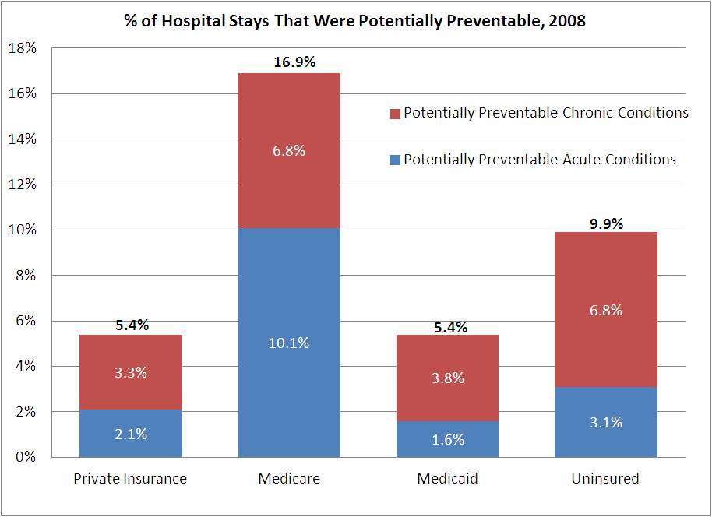
5-17% of Hospital Admissions
Are Potentially Preventable
Source:
AHRQ
HCUP

Slide 16
Millions of Preventable Events Harm Patients and Increase Costs
Medical Error | # Errors (2008) | Cost Per Error | Total U.S. Cost
Pressure Ulcers | 374,964 | $10,288 | $3,857,629,632
Postoperative Infection | 252,695 | $14,548 | $3,676,000,000
Complications of Implanted Device | 60,380 | $18,771 | $1,133,392,980
Infection Following Injection | 8,855 | $78,083 | $691,424,965
Pneumothorax | 25,559 | $24,132 | $616,789,788
Central Venous Catheter Infection | 7,062 | $83,365 | $588,723,630
Others | 773,808 | $11,640 | $9,007,039,005
TOTAL | 1,503,323 | $13,019 | $19,571,000,000
3 Adverse Events Every Minute
Source: The Economic Measurement of Medical Errors, Milliman and the Society of Actuaries, 2010

Slide 17
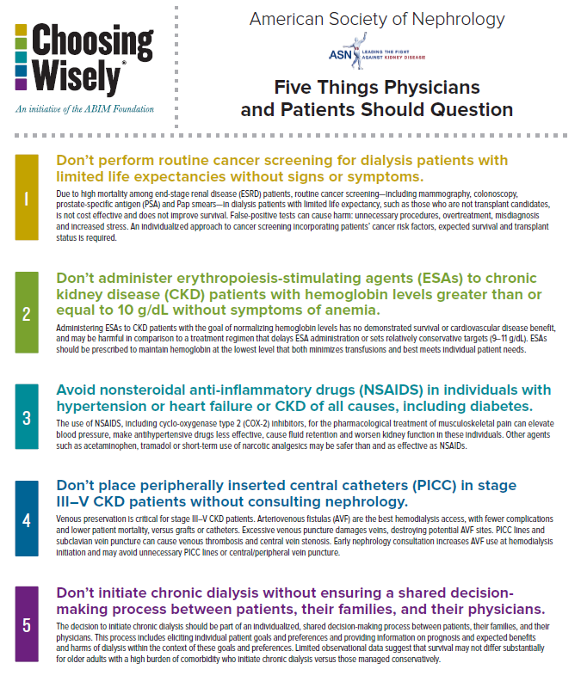
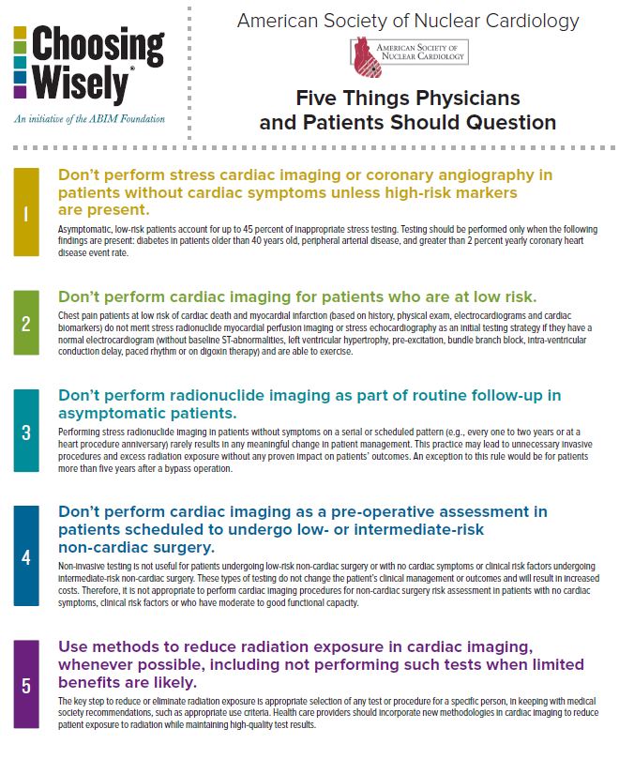
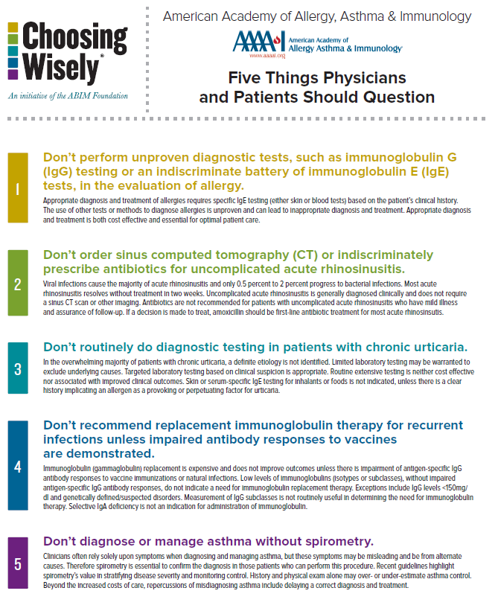
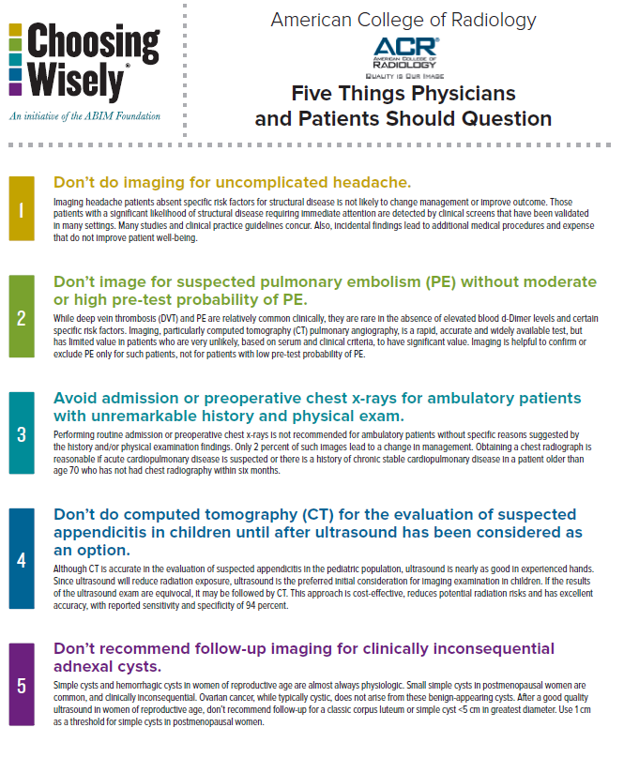
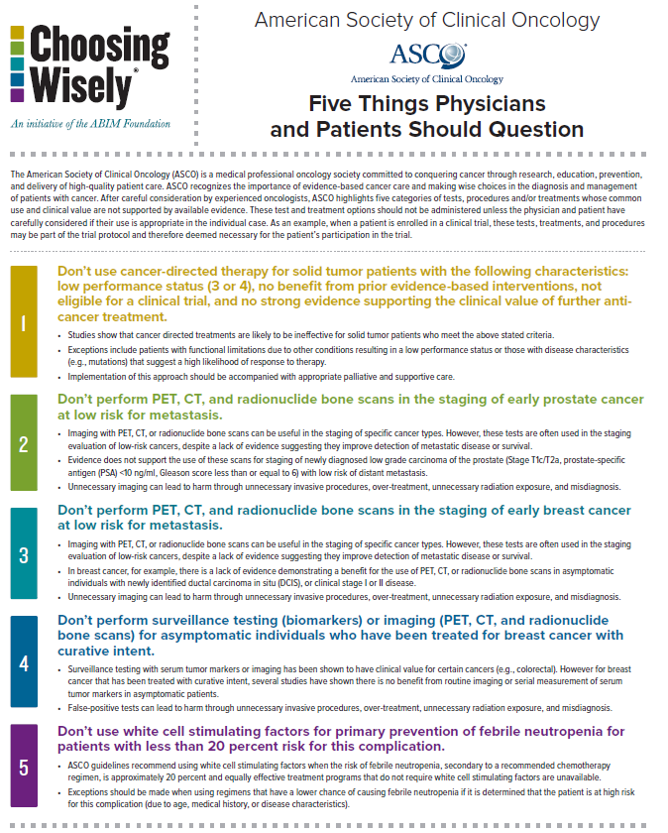
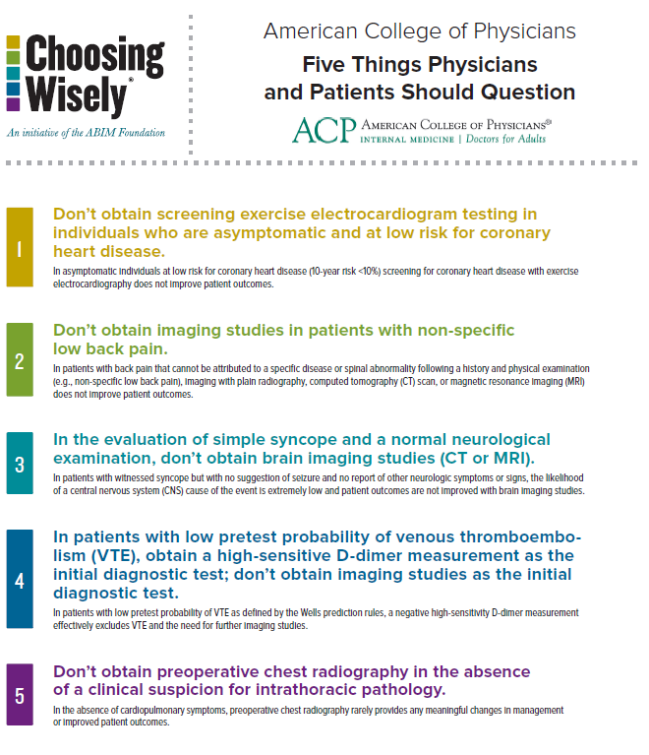
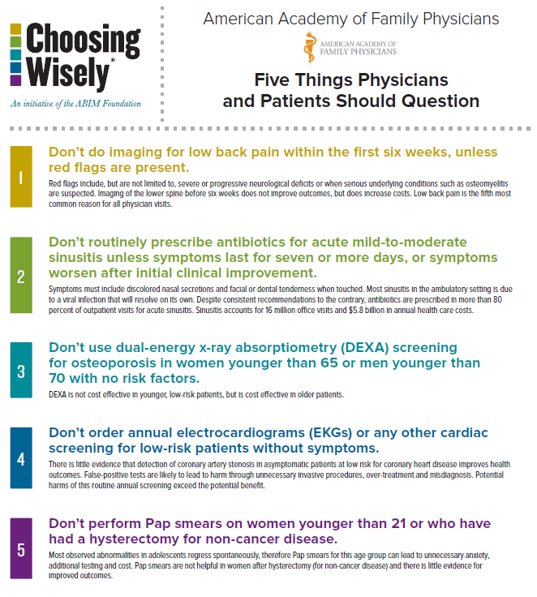
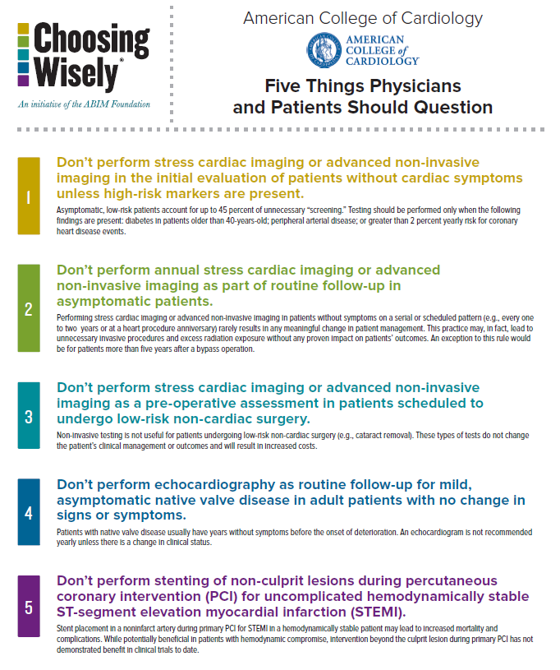
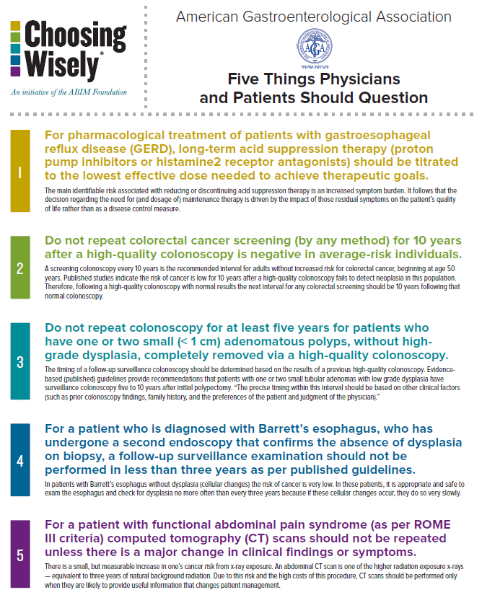
Many Ways to Reduce Tests & Services Without Harming Patients

Slide 18

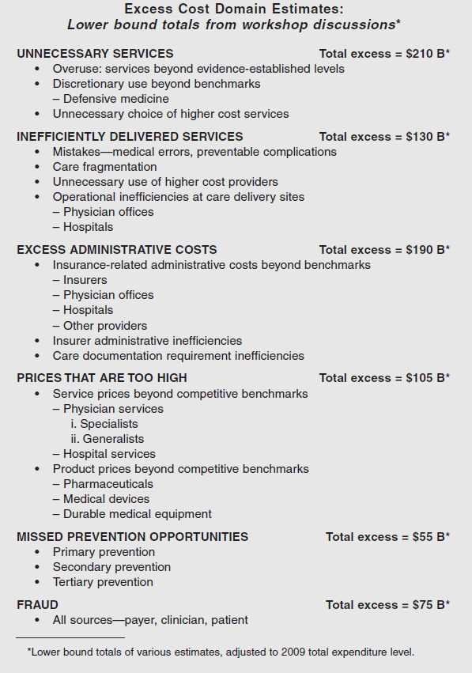
Institute of Medicine Estimate:
30% of Spending is Avoidable

Slide 19
The Right Goal: Less Avoidable $,
$
AVOIDABLE
SPENDING
AVOIDABLE
SPENDING
AVOIDABLE
SPENDING
AVOIDABLE
SPENDING
NECESSARY
SPENDING
TIME

Slide 20
The Right Goal: Less Avoidable $,
More Necessary $
$
AVOIDABLE
SPENDING
AVOIDABLE
SPENDING
AVOIDABLE
SPENDING
AVOIDABLE
SPENDING
NECESSARY
SPENDING
NECESSARY
SPENDING
NECESSARY
SPENDING
NECESSARY
SPENDING
TIME

Slide 21
Win-Win for Patients & Payers
$
AVOIDABLE
SPENDING
SAVINGS
SAVINGS
SAVINGS
AVOIDABLE
SPENDING
AVOIDABLE
SPENDING
AVOIDABLE
SPENDING
NECESSARY
SPENDING
NECESSARY
SPENDING
NECESSARY
SPENDING
NECESSARY
SPENDING
TIME

Slide 22
Barriers in the Payment System
Create a Win-Lose for Providers
$
AVOIDABLE
SPENDING
BARRIERS
IN THE
CURRENT
PAYMENT
SYSTEM
SAVINGS
AVOIDABLE
SPENDING
NECESSARY
SPENDING
NECESSARY
SPENDING

Slide 23
Barrier #1: No $ or Inadequate $ for High-Value Services
$
No Payment or
Inadequate Payment for:
AVOIDABLE
SPENDING
Services delivered
outside of face-to-face
visits with clinicians, e.g.,
phone calls, e-mails, etc.
Services delivered by
non-clinicians, e.g.,
nurses, community health
workers, etc.
Non-medical services,
e.g., transportation
Additional time or cost
for patients with
higher intensity needs
Services not covered by
benefit restrictions
NECESSARY
SPENDING
UNPAID
SERVICES

Slide 24
Barrier #2: Avoidable Spending May Be Revenue for Providers…
$
AVOIDABLE
SPENDING
PROVIDER
REVENUE
MARGIN
COST
OF
SERVICE
DELIVERY
NECESSARY
SPENDING

Slide 25
…And When Avoidable Services Aren’t Delivered…
$
AVOIDABLE
SPENDING
PROVIDER
REVENUE
MARGIN
COST
OF
SERVICE
DELIVERY
AVOIDABLE
SPENDING
NECESSARY
SPENDING
NECESSARY
SPENDING

Slide 26
…Providers’ Revenue
May Decrease…
$
AVOIDABLE
SPENDING
PROVIDER
REVENUE
MARGIN
COST
OF
SERVICE
DELIVERY
AVOIDABLE
SPENDING
PROVIDER
REVENUE
NECESSARY
SPENDING
NECESSARY
SPENDING

Slide 27
…But Providers’ Fixed Costs
Don’t Disappear…
$
Many Fixed Costs of Services
Remain When Volume Decreases
AVOIDABLE
SPENDING
PROVIDER
REVENUE
MARGIN
COST
OF
SERVICE
DELIVERY
COST
OF
SERVICE
DELIVERY
AVOIDABLE
SPENDING
PROVIDER
REVENUE
NECESSARY
SPENDING
NECESSARY
SPENDING

Slide 28
…Leaving Providers With Losses (or Bigger Losses Than Today)
$
Many Fixed Costs of Services
Remain When Volume Decreases
Potentially Causing Financial Losses
AVOIDABLE
SPENDING
PROVIDER
REVENUE
MARGIN
COST
OF
SERVICE
DELIVERY
LOSS
COST
OF
SERVICE
DELIVERY
AVOIDABLE
SPENDING
PROVIDER
REVENUE
NECESSARY
SPENDING
NECESSARY
SPENDING

Slide 29
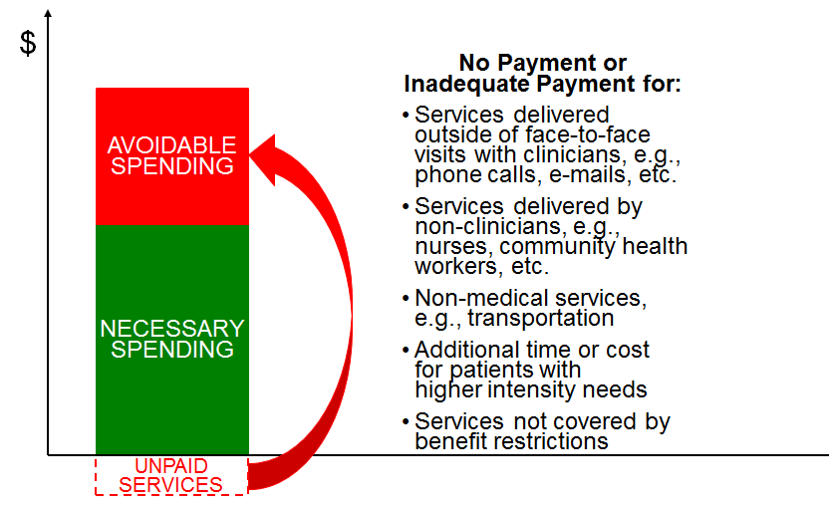
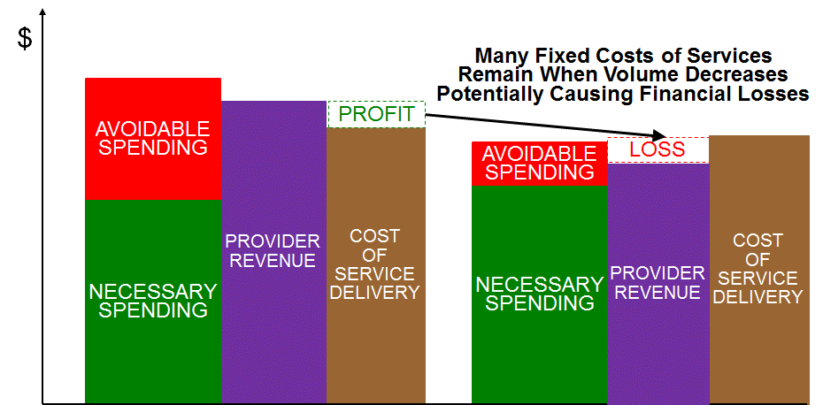
A Payment Change isn’t Reform
Unless It Removes the Barriers
BARRIER #1
BARRIER #2

Slide 30
So Why Haven’t We Fixed This??

Slide 31


Slide 32
In Healthcare,
Payers Are From Mars,
Providers Are From Venus

Slide 33
Provider Approach: Pay Us More…
PROVIDER
SOLUTION:
$
AVOIDABLE
SPENDING
NEWLY PAID
SERVICES
NECESSARY
SPENDING
NECESSARY
SPENDING
UNPAID
SERVICES

Slide 34
Provider Approach: Pay Us More… …and “Trust Us” on Savings
PROVIDER
SOLUTION:
$
AVOIDABLE
SPENDING
SAVINGS
AVOIDABLE
SPENDING
Provider to Payer:
“Paying for the services saved money
in a demonstration project,
so you can safely
assume that you will
also save money
if you pay all providers
to deliver the services
for all patients”
NEWLY PAID
SERVICES
NECESSARY
SPENDING
NECESSARY
SPENDING
UNPAID
SERVICES

Slide 35
Payer Concern: No Accountability to Reduce Avoidable Spending
PROVIDER
SOLUTION:
PAYER FEAR:
$
AVOIDABLE
SPENDING
AVOIDABLE
SPENDING
SAVINGS
AVOIDABLE
SPENDING
NEWLY PAID
SERVICES
NEWLY PAID
SERVICES
NECESSARY
SPENDING
NECESSARY
SPENDING
NECESSARY
SPENDING
UNPAID
SERVICES

Slide 36
In Healthcare,
Payers Are From Mars,
Providers Are From Venus

Slide 37
Payer Approach: Save Us Money and…
PAYER SOLUTION:
$
YEAR 1
AVOIDABLE
SPENDING
SAVINGS
AVOIDABLE
SPENDING
NECESSARY
SPENDING
NECESSARY
SPENDING
UNPAID
SERVICES
UNPAID
SERVICES

Slide 38
Payer Approach: Save Us Money and We’ll Pay You More Next Year
PAYER SOLUTION:
$
YEAR 1
YEAR 2
AVOIDABLE
SPENDING
SAVINGS
SAVINGS
AVOIDABLE
SPENDING
AVOIDABLE
SPENDING
P4P/ShrdSvgs
NECESSARY
SPENDING
NECESSARY
SPENDING
NECESSARY
SPENDING
UNPAID
SERVICES
UNPAID
SERVICES
UNPAID
SERVICES

Slide 39
Provider Concern: Shared Savings is Too Little, Too Late
PAYER SOLUTION:
$
YEAR 1
YEAR 2
AVOIDABLE
SPENDING
SAVINGS
SAVINGS
AVOIDABLE
SPENDING
AVOIDABLE
SPENDING
P4P/ShrdSvgs
NECESSARY
SPENDING
NECESSARY
SPENDING
NECESSARY
SPENDING
How
does
provider
cover
upfront
costs of
additional
services?
P4P or
shared
savings
may be
too little
too late
to cover
costs
UNPAID
SERVICES
UNPAID
SERVICES
UNPAID
SERVICES

Slide 40
It is unrealistic to expect providers
to improve quality or reduce spending
if the payment system does not provide
adequate financial support for their efforts.

Slide 41
It is unrealistic to expect providers
to improve quality or reduce spending
if the payment system does not provide
adequate financial support for their efforts.
It’s unrealistic to expect patients & purchasers
to pay more or differently without assurances that quality will be improved,
spending will be lower, or both.

Slide 42
It is unrealistic to expect providers
to improve quality or reduce spending
if the payment system does not provide
adequate financial support for their efforts.
It’s unrealistic to expect patients & purchasers
to pay more or differently without assurances that quality will be improved,
spending will be lower, or both.
Payment reforms must be designed
to support delivery of
higher-quality care for patients
at lower costs for purchasers
in ways that are
financially feasible for providers.

Slide 43
A Successful Compromise:
#1: Identify Avoidable Spending
OPPORTUNITIES TO REDUCE OTHER SPENDING
Avoidable Admissions and Readmissions
Unnecessary Tests
Use of Lower-Cost Settings
  Home care instead of facility-based care
More Efficient Delivery of Treatments
  Shorter inpatient stays
Preventable Complications of Treatment
  Infections, medication side effects
$
AVOIDABLE
SPENDING
PROVIDER
CAN
CONTROL
NECESSARY
SPENDING
PROVIDER
CAN
CONTROL

Slide 44
A Successful Compromise:
#2: Identify Barriers in Payment
OPPORTUNITIES TO REDUCE OTHER SPENDING
Avoidable Admissions and Readmissions
Unnecessary Tests
Use of Lower-Cost Settings
  Home care instead of facility-based care
More Efficient Delivery of Treatments
  Shorter inpatient stays
Preventable Complications of Treatment
  Infections, medication side effects
$
AVOIDABLE
SPENDING
PROVIDER
CAN
CONTROL
NECESSARY
SPENDING
PROVIDER
CAN
CONTROL
BARRIERS IN CURRENT FFS SYSTEM
No payment for non-face-to-face services
No payment for nurse care managers
No payment for telemedicine services
No payment for coordination calls with PCPs
UNPAID
SERVICES

Slide 45
A Successful Compromise:
#3: Remove the Barriers
PROVIDER-
PAYER
AGREEMENT
$
AVOIDABLE
SPENDING
PROVIDER
CAN
CONTROL
NEWLY PAID
SERVICES
Upfront payment to support
improved delivery of care
NECESSARY
SPENDING
PROVIDER
CAN
CONTROL
NECESSARY
SPENDING
UNPAID
SERVICES

Slide 46
A Successful Compromise:
#4: Take Accountability for Results
PROVIDER-
PAYER
AGREEMENT
$
AVOIDABLE
SPENDING
PROVIDER
CAN
CONTROL
SAVINGS
Commitment to reduce avoidable
spending sufficiently to achieve savings
AVOIDABLE
SPENDING
NEWLY PAID
SERVICES
Upfront payment to support
improved delivery of care
NECESSARY
SPENDING
PROVIDER
CAN
CONTROL
NECESSARY
SPENDING
UNPAID
SERVICES

Slide 47
Accountability is Assured
As Part of the Payment Contract
PROVIDER-
PAYER
AGREEMENT
IF SAVINGS
IS NOT
ACHIEVED..
…PROVIDER
PAYMENT
REDUCED
$
AVOIDABLE
SPENDING
PROVIDER
CAN
CONTROL
SAVINGS
AVOIDABLE
SPENDING
SAVINGS
AVOIDABLE
SPENDING
AVOIDABLE
SPENDING
NEWLY PAID
SERVICES
NEWLY PAID
SERVICES
PROVIDER $
NECESSARY
SPENDING
PROVIDER
CAN
CONTROL
NECESSARY
SPENDING
NECESSARY
SPENDING
NECESSARY
SPENDING
UNPAID
SERVICES

Slide 48
“Alternative Payment Models”
Can Be Win-Win-Wins
PROVIDER-
PAYER
AGREEMENT
$
Win for Payer:
Lower Total Spending
AVOIDABLE
SPENDING
PROVIDER
CAN
CONTROL
SAVINGS
Win for Patient:
Better Care Without
Unnecessary Services
AVOIDABLE
SPENDING
NEWLY PAID
SERVICES
Win for Provider:
Adequate Payment for
High-Value Services
NECESSARY
SPENDING
PROVIDER
CAN
CONTROL
NECESSARY
SPENDING
UNPAID
SERVICES

Slide 49
Today: Reactive Care for Chronic Disease, Many Hospitalizations
 |  | CURRENT
 |  | $/Patient | # Pts | Total $
Physician Svcs
 | PCP | $600 | 500 | $300,000
Hospitalizations
 | Admissions | $10,000 | 250 | $2,500,000
Specialist |  | $400 | 250 | $100,000
Total Spending |  |  | 500 | $2,900,000
500 Moderately
Severe Chronic
Disease Patients
PCP paid only for
periodic office visits
(6 visits @ $100/visit)
Patients do not take
maintenance medications
reliably
50% of patients are
hospitalized each year
for exacerbations
Specialist only
sees patient during
hospital admissions

Slide 50
Is There a Better Way?
 |  | CURRENT |  |  |  | FUTURE
 |  | $/Patient | # Pts | Total $ |  | $/Pt | # Pts | Total $ |  | Chg
Physician Svcs |  |  |  |  |  | ? |  | ?
 | PCP | $600 | 500 | $300,000 |  | ? |  | ?
Hospitalizations |  |  |  |  |  | ? |  | ?
 | Admissions | $10,000 | 250 | $2,500,000 |  | ? |  | ?
Specialist |  | $400 | 250 | $100,000 |  | ? |  | ?
Total Spending |  |  | 500 | $2,900,000 |  | ? |  | ?

Slide 51
Pay the PCP for
Proactive Care Management
 |  | CURRENT |  |  |  | FUTURE
 |  | $/Patient | # Pts | Total $ |  | $/Pt | # Pts | Total $ |  | Chg
Physician Svcs
 | PCP | $600 | 500 | $300,000 |  | $900 | 500 | $450,000 |  | +50%
Hospitalizations
 | Admissions | $10,000 | 250 | $2,500,000
Specialist |  | $400 | 250 | $100,000
Total Spending |  |  | 500 | $2,900,000
Pay PCP $75 per patient per month instead of $100 per visit

Slide 52
Pay the Specialist to Co-Manage
The Patient’s Care
 |  | CURRENT |  |  |  | FUTURE
 |  | $/Patient | # Pts | Total $ |  | $/Pt | # Pts | Total $ |  | Chg
Physician Svcs
 | PCP | $600 | 500 | $300,000 |  | $900 | 500 | $450,000 |  | +50%
 | Specialist |  |  |  |  | $300 | 500 | $150,000 |  | +50%
Hospitalizations
 | Admissions | $10,000 | 250 | $2,500,000
Specialist (Inpt) |  | $400 | 250 | $100,000 |  |  |  | $0
Total Spending |  |  | 500 | $2,900,000
Pay PCP $75 per patient per month instead of $100 per visit
Pay specialist $25 per patient per month instead of $100 per hospital day

Slide 53
Provide Non-Physician Resources to Support Patients
 |  | CURRENT |  |  |  | FUTURE
 |  | $/Patient | # Pts | Total $ |  | $/Pt | # Pts | Total $ |  | Chg
Physician Svcs
 | PCP | $600 | 500 | $300,000 |  | $900 | 500 | $450,000 |  | +50%
 | Specialist |  |  |  |  | $300 | 500 | $150,000 |  | +50%
 | RN Care Mgr |  |  |  |  |  |  | $80,000
Hospitalizations
 | Admissions | $10,000 | 250 | $2,500,000
Specialist (Inpt) |  | $400 | 250 | $100,000 |  |  |  | $0
Total Spending |  |  | 500 | $2,900,000
Pay PCP $75 per patient per month instead of $100 per visit
Pay specialist $25 per patient per month instead of $100 per hospital day
Pay the primary care practice enough to hire a nurse care manager

Slide 54
Can We Afford a 127% Increase in Spending on Ambulatory Care?
 |  | CURRENT |  |  |  | FUTURE
 |  | $/Patient | # Pts | Total $ |  | $/Pt | # Pts | Total $ |  | Chg
Physician Svcs
 | PCP | $600 | 500 | $300,000 |  | $900 | 500 | $450,000 |  | +50%
 | Specialist |  |  |  |  | $300 | 500 | $150,000 |  | +50%
 | RN Care Mgr |  |  |  |  |  |  | $80,000
 | Total |  |  | $300,000 |  |  | 500 | $680,000 |  | 127%
Hospitalizations
 | Admissions | $10,000 | 250 | $2,500,000
Specialist (Inpt) |  | $400 | 250 | $100,000 |  |  |  | $0
Total Spending |  |  | 500 | $2,900,000
Pay PCP $75 per patient per month instead of $100 per visit
Pay specialist $25 per patient per month instead of $100 per hospital day
Pay the primary care practice enough to hire a nurse care manager

Slide 55
Yes, If It Succeeds In
Reducing Hospitalizations
 |  | CURRENT |  |  |  | FUTURE
 |  | $/Patient | # Pts | Total $ |  | $/Pt | # Pts | Total $ |  | Chg
Physician Svcs
 | PCP | $600 | 500 | $300,000 |  | $900 | 500 | $450,000 |  | +50%
 | Specialist |  |  |  |  | $300 | 500 | $150,000 |  | +50%
 | RN Care Mgr |  |  |  |  |  |  | $80,000
 | Total |  |  | $300,000 |  |  | 500 | $680,000 |  | 127%
Hospitalizations
 | Admissions | $10,000 | 250 | $2,500,000 |  | $10,000 | 215 | $2,150,000 |  | -14%
Specialist (Inpt) |  | $400 | 250 | $100,000 |  |  |  | $0
Total Spending |  |  | 500 | $2,900,000 |  |  | 500 | $2,830,000 |  | -2.5%

Slide 56
Improved Chronic Disease Mgt Can Potentially Generate Large Savings
 |  | CURRENT |  |  |  | FUTURE
 |  | $/Patient | # Pts | Total $ |  | $/Pt | # Pts | Total $ |  | Chg
Physician Svcs
 | PCP | $600 | 500 | $300,000 |  | $900 | 500 | $450,000 |  | +50%
 | Specialist |  |  |  |  | $300 | 500 | $150,000 |  | +50%
 | RN Care Mgr |  |  |  |  |  |  | $80,000
 | Total |  |  | $300,000 |  |  | 500 | $680,000 |  | 127%
Hospitalizations
 | Admissions | $10,000 | 250 | $2,500,000 |  | $10,000 | 150 | $1,500,000 |  | -40%
Specialist (Inpt) |  | $400 | 250 | $100,000 |  |  |  | $0
Total Spending |  |  | 500 | $2,900,000 |  |  | 500 | $2,180,000 |  | -25%

Slide 57
Do Wins for Patients, Docs & Payers Require Losses for Hospitals?
 |  | CURRENT |  |  |  | FUTURE
 |  | $/Patient | # Pts | Total $ |  | $/Pt | # Pts | Total $ |  | Chg
Physician Svcs
 | PCP | $600 | 500 | $300,000 |  | $900 | 500 | $450,000 |  | +50%
 | Specialist |  |  |  |  | $300 | 500 | $150,000 |  | +50%
 | RN Care Mgr |  |  |  |  |  |  | $80,000
 | Total |  |  | $300,000 |  |  | 500 | $680,000 |  | 127%
Hospitalizations
 | Admissions | $10,000 | 250 | $2,500,000 |  | $10,000 | 150 | $1,500,000 |  | -40%
Specialist (Inpt) |  | $400 | 250 | $100,000 |  |  |  | $0
Total Spending |  |  | 500 | $2,900,000 |  |  | 500 | $2,180,000 |  | -25%

Slide 58
What Should Matter to Hospitals is Margin, Not Revenues (Volume)

Slide 59
Hospital Costs Are Not Proportional to Utilization
7% reduction
in cost
20% reduction in volume

Slide 60
Reductions in Utilization Reduce Revenues More Than Costs
7% reduction
in cost
20% reduction in volume
20% reduction
in revenue

Slide 61
Causing Negative Margins for Hospitals
Payers Will Be
Underpaying For
Care If
Admissions,
Readmissions, Etc.
Are Reduced

Slide 62
But Spending Can Be Reduced Without Bankrupting Hospitals
Payers Can
Still Save $
Without Causing
Negative Margins
for Hospital

Slide 63
Where Does the
Hospital Payment Go?
 |  | CURRENT |  |  |  | FUTURE
 |  | $/Patient | # Pts | Total $ |  | $/Pt | # Pts | Total $ |  | Chg
Physician Svcs
 | PCP | $600 | 500 | $300,000 |  | $900 | 500 | $450,000 |  | +50%
 | Specialist |  |  |  |  | $300 | 500 | $150,000 |  | +50%
 | RN Care Mgr |  |  |  |  |  |  | $80,000
 | Total |  |  | $300,000 |  |  | 500 | $680,000 |  | 127%
Hospitalizations
 | Admissions | $10,000 | 250 | $2,500,000 |  | $10,000 | 150 | $1,500,000 |  | -40%
Specialist (Inpt) |  | $400 | 250 | $100,000 |  |  |  | $0
Total Spending |  |  | 500 | $2,900,000 |  |  | 500 | $2,180,000 |  | -25%

Slide 64
Analyze the Hospital’s
Cost Structure
 |  | CURRENT |  |  |  | FUTURE
 |  | $/Patient | # Pts | Total $ |  | $/Pt | # Pts | Total $ |  | Chg
Physician Svcs
 | PCP | $600 | 500 | $300,000 |  | $900 | 500 | $450,000 |  | +50%
 | Specialist |  |  |  |  | $300 | 500 | $150,000 |  | +50%
 | RN Care Mgr |  |  |  |  |  |  | $80,000
 | Total |  |  | $300,000 |  |  | 500 | $680,000 |  | 127%
Hospitalizations
 | Hospital Fixed | $6,000 | 60% | $1,500,000
 | Hosp. Variable | $3,700 | 37% | $925,000
 | Hosp. Margin | $300 | 3% | $75,000
 | Total | $10,000 | 250 | $2,500,000
Specialist (Inpt) |  | $400 | 250 | $100,000
Total Spending |  |  | 500 | $2,900,000

Slide 65
What Happens to Hospital Finances When Admissions Go Down?
 |  | CURRENT |  |  |  | FUTURE
 |  | $/Patient | # Pts | Total $ |  | $/Pt | # Pts | Total $ |  | Chg
Physician Svcs
 | PCP | $600 | 500 | $300,000 |  | $900 | 500 | $450,000 |  | +50%
 | Specialist |  |  |  |  | $300 | 500 | $150,000 |  | +50%
 | RN Care Mgr |  |  |  |  |  |  | $80,000
 | Total |  |  | $300,000 |  |  | 500 | $680,000 |  | 127%
Hospitalizations
 | Hospital Fixed | $6,000 | 60% | $1,500,000
 | Hosp. Variable | $3,700 | 37% | $925,000
 | Hosp. Margin | $300 | 3% | $75,000
 | Total | $10,000 | 250 | $2,500,000 |  |  | 150
Specialist (Inpt) |  | $400 | 250 | $100,000 |  |  |  | $0
Total Spending |  |  | 500 | $2,900,000

Slide 66
Continue to Cover the Fixed Costs
 |  | CURRENT |  |  |  | FUTURE
 |  | $/Patient | # Pts | Total $ |  | $/Pt | # Pts | Total $ |  | Chg
Physician Svcs
 | PCP | $600 | 500 | $300,000 |  | $900 | 500 | $450,000 |  | +50%
 | Specialist |  |  |  |  | $300 | 500 | $150,000 |  | +50%
 | RN Care Mgr |  |  |  |  |  |  | $80,000
 | Total |  |  | $300,000 |  |  | 500 | $680,000 |  | 127%
Hospitalizations
 | Hospital Fixed | $6,000 | 60% | $1,500,000 |  |  |  | $1,500,000 |  | -0%
 | Hosp. Variable | $3,700 | 37% | $925,000
 | Hosp. Margin | $300 | 3% | $75,000
 | Total | $10,000 | 250 | $2,500,000 |  |  | 150
Specialist (Inpt) |  | $400 | 250 | $100,000 |  |  |  | $0
Total Spending |  |  | 500 | $2,900,000

Slide 67
Save on Variable Costs
With Fewer Patients
 |  | CURRENT |  |  |  | FUTURE
 |  | $/Patient | # Pts | Total $ |  | $/Pt | # Pts | Total $ |  | Chg
Physician Svcs
 | PCP | $600 | 500 | $300,000 |  | $900 | 500 | $450,000 |  | +50%
 | Specialist |  |  |  |  | $300 | 500 | $150,000 |  | +50%
 | RN Care Mgr |  |  |  |  |  |  | $80,000
 | Total |  |  | $300,000 |  |  | 500 | $680,000 |  | 127%
Hospitalizations
 | Hospital Fixed | $6,000 | 60% | $1,500,000 |  |  |  | $1,500,000 |  | -0%
 | Hosp. Variable | $3,700 | 37% | $925,000 |  | $3,700 |  | $555,000 |  | -40%
 | Hosp. Margin | $300 | 3% | $75,000
 | Total | $10,000 | 250 | $2,500,000 |  |  | 150
Specialist (Inpt) |  | $400 | 250 | $100,000 |  |  |  | $0
Total Spending |  |  | 500 | $2,900,000

Slide 68
Increase the Hospital’s
Contribution Margin
 |  | CURRENT |  |  |  | FUTURE
 |  | $/Patient | # Pts | Total $ |  | $/Pt | # Pts | Total $ |  | Chg
Physician Svcs
 | PCP | $600 | 500 | $300,000 |  | $900 | 500 | $450,000 |  | +50%
 | Specialist |  |  |  |  | $300 | 500 | $150,000 |  | +50%
 | RN Care Mgr |  |  |  |  |  |  | $80,000
 | Total |  |  | $300,000 |  |  | 500 | $680,000 |  | 127%
Hospitalizations
 | Hospital Fixed | $6,000 | 60% | $1,500,000 |  |  |  | $1,500,000 |  | -0%
 | Hosp. Variable | $3,700 | 37% | $925,000 |  |  |  | $555,000 |  | -40%
 | Hosp. Margin | $300 | 3% | $75,000 |  |  |  | $82,500 |  | +10%
 | Total | $10,000 | 250 | $2,500,000 |  |  | 150
Specialist (Inpt) |  | $400 | 250 | $100,000 |  |  |  | $0
Total Spending |  |  | 500 | $2,900,000

Slide 69
Hospital Gets Less Total Revenue,
But is Better Off Financially
 |  | CURRENT |  |  |  | FUTURE
 |  | $/Patient | # Pts | Total $ |  | $/Pt | # Pts | Total $ |  | Chg
Physician Svcs
 | PCP | $600 | 500 | $300,000 |  | $900 | 500 | $450,000 |  | +50%
 | Specialist |  |  |  |  | $300 | 500 | $150,000 |  | +50%
 | RN Care Mgr |  |  |  |  |  |  | $80,000
 | Total |  |  | $300,000 |  |  | 500 | $680,000 |  | 127%
Hospitalizations
 | Hospital Fixed | $6,000 | 60% | $1,500,000 |  |  |  | $1,500,000 |  | -0%
 | Hosp. Variable | $3,700 | 37% | $925,000 |  |  |  | $555,000 |  | -40%
 | Hosp. Margin | $300 | 3% | $75,000 |  |  |  | $82,500 |  | +10%
 | Total | $10,000 | 250 | $2,500,000 |  |  | 150 | $2,137,500 |  | -15%
Specialist (Inpt) |  | $400 | 250 | $100,000 |  |  |  | $0
Total Spending |  |  | 500 | $2,900,000

Slide 70
And the Payer Still Spends Less
 |  | CURRENT |  |  |  | FUTURE
 |  | $/Patient | # Pts | Total $ |  | $/Pt | # Pts | Total $ |  | Chg
Physician Svcs
 | PCP | $600 | 500 | $300,000 |  | $900 | 500 | $450,000 |  | +50%
 | Specialist |  |  |  |  | $300 | 500 | $150,000 |  | +50%
 | RN Care Mgr |  |  |  |  |  |  | $80,000
 | Total |  |  | $300,000 |  |  | 500 | $680,000 |  | 127%
Hospitalizations
 | Hospital Fixed | $6,000 | 60% | $1,500,000 |  |  |  | $1,500,000 |  | -0%
 | Hosp. Variable | $3,700 | 37% | $925,000 |  |  |  | $555,000 |  | -40%
 | Hosp. Margin | $300 | 3% | $75,000 |  |  |  | $82,500 |  | +10%
 | Total | $10,000 | 250 | $2,500,000 |  |  | 150 | $2,137,500 |  | -15%
Specialist (Inpt) |  | $400 | 250 | $100,000 |  |  |  | $0
Total Spending |  |  | 500 | $2,900,000 |  |  | 500 | $2,817,500 |  | -3%

Slide 71
Win-Win-Win: Better Care, Higher Physician Pay, Lower Spending
 |  | CURRENT |  |  |  | FUTURE
 |  | $/Patient | # Pts | Total $ |  | $/Pt | # Pts | Total $ |  | Chg
Physician Svcs
 | PCP | $600 | 500 | $300,000 |  | $900 | 500 | $450,000 |  | +50%
 | Specialist |  |  |  |  | $300 | 500 | $150,000 |  | +50%
 | RN Care Mgr |  |  |  |  |  |  | $80,000
 | Total |  |  | $300,000 |  |  | 500 | $680,000 |  | 127%
Hospitalizations
 | Hospital Fixed | $6,000 | 60% | $1,500,000 |  |  |  | $1,500,000 |  | -0%
 | Hosp. Variable | $3,700 | 37% | $925,000 |  |  |  | $555,000 |  | -40%
 | Hosp. Margin | $300 | 3% | $75,000 |  |  |  | $82,500 |  | +10%
 | Total | $10,000 | 250 | $2,500,000 |  |  | 150 | $2,137,500 |  | -15%
Specialist (Inpt) |  | $400 | 250 | $100,000 |  |  |  | $0
Total Spending |  |  | 500 | $2,900,000 |  |  | 500 | $2,817,500 |  | -3%
Physicians Win
Hospital Wins
Payer Wins

Slide 72
What Payment Model Supports This Win-Win-Win Approach?
 |  | CURRENT |  |  |  | FUTURE
 |  | $/Patient | # Pts | Total $ |  | $/Pt | # Pts | Total $ |  | Chg
Physician Svcs
 | PCP | $600 | 500 | $300,000 |  | $900 | 500 | $450,000 |  | +50%
 | Specialist |  |  |  |  | $300 | 500 | $150,000 |  | +50%
 | RN Care Mgr |  |  |  |  |  |  | $80,000
 | Total |  |  | $300,000 |  |  | 500 | $680,000 |  | 127%
Hospitalizations
 | Hospital Fixed | $6,000 | 60% | $1,500,000 |  |  |  | $1,500,000 |  | -0%
 | Hosp. Variable | $3,700 | 37% | $925,000 |  |  |  | $555,000 |  | -40%
 | Hosp. Margin | $300 | 3% | $75,000 |  |  |  | $82,500 |  | +10%
 | Total | $10,000 | 250 | $2,500,000 |  |  | 150 | $2,137,500 |  | -15%
Specialist (Inpt) |  | $400 | 250 | $100,000 |  |  |  | $0
Total Spending |  |  | 500 | $2,900,000 |  |  | 500 | $2,817,500 |  | -3%

Slide 73
You Don’t Want to Try and Renegotiate Individual Fees
 |  | CURRENT |  |  |  | FUTURE
 |  | $/Patient | # Pts | Total $ |  | $/Pt | # Pts | Total $ |  | Chg
Physician Svcs
 | PCP | $600 | 500 | $300,000 |  | $900 | 500 | $450,000 |  | +50%
 | Specialist |  |  |  |  | $300 | 500 | $150,000 |  | +50%
 | RN Care Mgr |  |  |  |  |  |  | $80,000
 | Total |  |  | $300,000 |  |  | 500 | $680,000 |  | 127%
Hospitalizations
 | Hospital Fixed | $6,000 | 60% | $1,500,000 |  |  |  | $1,500,000 |  | -0%
 | Hosp. Variable | $3,700 | 37% | $925,000 |  |  |  | $555,000 |  | -40%
 | Hosp. Margin | $300 | 3% | $75,000 |  |  |  | $82,500 |  | +10%
 | Total | $10,000 | 250 | $2,500,000 |  | $14,250 | 150 | $2,137,500 |  | -15%
Specialist (Inpt) |  | $400 | 250 | $100,000 |  |  |  | $0
Total Spending |  |  | 500 | $2,900,000 |  |  | 500 | $2,817,500 |  | -3%

Slide 74
…What Assures The Payer That
There Will Be Fewer Admissions?
 |  | CURRENT |  |  |  | FUTURE
 |  | $/Patient | # Pts | Total $ |  | $/Pt | # Pts | Total $ |  | Chg
Physician Svcs
 | PCP | $600 | 500 | $300,000 |  | $900 | 500 | $450,000 |  | +50%
 | Specialist |  |  |  |  | $300 | 500 | $150,000 |  | +50%
 | RN Care Mgr |  |  |  |  |  |  | $80,000
 | Total |  |  | $300,000 |  |  | 500 | $680,000 |  | 127%
Hospitalizations
 | Hospital Fixed | $6,000 | 60% | $1,500,000 |  |  |  | $1,500,000 |  | -0%
 | Hosp. Variable | $3,700 | 37% | $925,000 |  |  |  | $555,000 |  | -40%
 | Hosp. Margin | $300 | 3% | $75,000 |  |  |  | $82,500 |  | +10%
 | Total | $10,000 | 250 | $2,500,000 |  | $14,250 | 150 | $2,137,500 |  | -15%
Specialist (Inpt) |  | $400 | 250 | $100,000 |  |  |  | $0
Total Spending |  |  | 500 | $2,900,000 |  |  | 500 | $2,817,500 |  | -3%
?

Slide 75
Look at What is Being Spent Today in Total on the Patient’s Condition
 |  | CURRENT |  |  |  | FUTURE
 |  | $/Patient | # Pts | Total $ |  | $/Pt | # Pts | Total $ |  | Chg
Physician Svcs
 | PCP | $600 | 500 | $300,000
 | Specialist
 | RN Care Mgr
 | Total |  |  | $300,000
Hospitalizations
 | Hospital Fixed | $6,000 | 60% | $1,500,000
 | Hosp. Variable | $3,700 | 37% | $925,000
 | Hosp. Margin | $300 | 3% | $75,000
 | Total |  | 250 | $2,500,000
Specialist (Inpt) |  | $400 | 250 | $100,000
Total Spending |  | $5,800 | 500 | $2,900,000

Slide 76
Tell the Payer You’ll Do It For Less
Than They’re Spending Today
 |  | CURRENT |  |  |  | FUTURE
 |  | $/Patient | # Pts | Total $ |  | $/Pt | # Pts | Total $ |  | Chg
Physician Svcs
 | PCP | $600 | 500 | $300,000
 | Specialist
 | RN Care Mgr
 | Total |  |  | $300,000
Hospitalizations
 | Hospital Fixed | $6,000 | 60% | $1,500,000
 | Hosp. Variable | $3,700 | 37% | $925,000
 | Hosp. Margin | $300 | 3% | $75,000
 | Total |  | 250 | $2,500,000
Specialist (Inpt) |  | $400 | 250 | $100,000
Total Spending |  | $5,800 | 500 | $2,900,000 |  | $5,635 | 500 | $2,817,500 |  | -3%

Slide 77
Use the Payment as a Budget to Redesign Care…
 |  | CURRENT |  |  |  | FUTURE
 |  | $/Patient | # Pts | Total $ |  | $/Pt | # Pts | Total $ |  | Chg
Physician Svcs
 | PCP | $600 | 500 | $300,000 |  |  | 500 | $450,000 |  | +50%
 | Specialist |  |  |  |  |  | 500 | $150,000 |  | +50%
 | RN Care Mgr |  |  |  |  |  |  | $80,000
 | Total |  |  | $300,000 |  |  |  | $680,000 |  | 127%
Hospitalizations
 | Hospital Fixed | $6,000 | 60% | $1,500,000 |  |  |  | $1,500,000 |  | -0%
 | Hosp. Variable | $3,700 | 37% | $925,000 |  |  |  | $555,000 |  | -40%
 | Hosp. Margin | $300 | 3% | $75,000 |  |  |  | $82,500 |  | +10%
 | Total |  |  | $2,500,000 |  |  |  | $2,137,500 |  | -15%
Specialist (Inpt) |  | $400 | 250 | $100,000 |  |  |  | $0
Total Spending |  | $5,800 | 500 | $2,900,000 |  | $5,635 | 500 | $2,817,500 |  | -3%

Slide 78
…And Let Providers Decide
How They Should Be Paid
 |  | CURRENT |  |  |  | FUTURE
 |  | $/Patient | # Pts | Total $ |  | $/Pt | # Pts | Total $ |  | Chg
Physician Svcs
 | PCP | $600 | 500 | $300,000 |  | $900 | 500 | $450,000 |  | +50%
 | Specialist |  |  |  |  | $300 | 500 | $150,000 |  | +50%
 | RN Care Mgr |  |  |  |  |  |  | $80,000
 | Total |  |  | $300,000 |  |  |  | $680,000 |  | 127%
Hospitalizations
 | Hospital Fixed | $6,000 | 60% | $1,500,000 |  |  |  | $1,500,000 |  | -0%
 | Hosp. Variable | $3,700 | 37% | $925,000 |  |  |  | $555,000 |  | -40%
 | Hosp. Margin | $300 | 3% | $75,000 |  |  |  | $82,500 |  | +10%
 | Total |  |  | $2,500,000 |  |  |  | $2,137,500 |  | -15%
Specialist (Inpt) |  | $400 | 250 | $100,000 |  |  |  | $0
Total Spending |  | $5,800 | 500 | $2,900,000 |  | $5,635 | 500 | $2,817,500 |  | -3%

Slide 79
Condition-Based Payment Puts the Providers in Charge of Care & Pmt
 |  | CURRENT |  |  |  | FUTURE
 |  | $/Patient | # Pts | Total $ |  | $/Pt | # Pts | Total $ |  | Chg
Physician Svcs
 | PCP | $600 | 500 | $300,000 |  | $900 | 500 | $450,000 |  | +50%
 | Specialist |  |  |  |  | $300 | 500 | $150,000 |  | +50%
 | RN Care Mgr |  |  |  |  |  |  | $80,000
 | Total |  |  | $300,000 |  |  |  | $680,000 |  | 127%
Hospitalizations
 | Hospital Fixed | $6,000 | 60% | $1,500,000 |  |  |  | $1,500,000 |  | -0%
 | Hosp. Variable | $3,700 | 37% | $925,000 |  |  |  | $555,000 |  | -40%
 | Hosp. Margin | $300 | 3% | $75,000 |  |  |  | $82,500 |  | +10%
 | Total |  |  | $2,500,000 |  |  |  | $2,137,500 |  | -15%
Specialist (Inpt) |  | $400 | 250 | $100,000 |  |  |  | $0
Total Spending |  | $5,800 | 500 | $2,900,000 |  | $5,635 | 500 | $2,817,500 |  | -3%

Slide 80
All Services Are Now Costs to the Provider Receiving the Payment
 |  | CURRENT |  |  |  | FUTURE
 |  | $/Patient | # Pts | Total $ |  | $/Pt | # Pts | Total $ |  | Chg
Physician Svcs
 | PCP | $600 | 500 | $300,000 |  | $900 | 500 | $450,000 |  | +50%
 | Specialist |  |  |  |  | $300 | 500 | $150,000 |  | +50%
 | RN Care Mgr |  |  |  |  |  |  | $80,000
 | Total |  |  | $300,000 |  |  |  | $680,000 |  | 127%
Hospitalizations
 | Hospital Fixed | $6,000 | 60% | $1,500,000 |  |  |  | $1,500,000 |  | -0%
 | Hosp. Variable | $3,700 | 37% | $925,000 |  |  |  | $555,000 |  | -40%
 | Hosp. Margin | $300 | 3% | $75,000 |  |  |  | $82,500 |  | +10%
 | Total |  |  | $2,500,000 |  |  |  | $2,137,500 |  | -15%
Specialist (Inpt) |  | $400 | 250 | $100,000 |  |  |  | $0
Total Spending |  | $5,800 | 500 | $2,900,000 |  | $5,635 | 500 | $2,817,500 |  | -3%
COST
REVENUE

Slide 81
Providers Have Accountability,
But Also Flexibility
 |  | BUSINESS PLAN
 |  | $/Patient | # Pts | Total $
Physician Svcs
 | PCP | $900 | 500 | $450,000
 | Specialist | $300 | 500 | $150,000
 | RN Care Mgr |  |  | $80,000
 | Total |  |  | $680,000
Hospitalizations
 | Hospital Fixed |  |  | $1,500,000
 | Hosp. Variable | $3,700 | 150 | $555,000
 | Hosp. Margin |  |  | $82,500
 | Total |  | 150 | $2,137,500
Total Spending |  | $5,635 | 500 | $2,817,500
PMPY Payment |  | $5,635 | 500 | $2,817,500
Margin |  |  |  | $0
COST
REVENUE

Slide 82
Failure to Reduce Hospitalizations
Sufficiently …
 |  | BUSINESS PLAN |  |  |  | ACTUAL
 |  | $/Patient | # Pts | Total $ |  | $/Pt | # Pts | Total $
Physician Svcs
 | PCP | $900 | 500 | $450,000 |  | $900 | 500 | $450,000
 | Specialist | $300 | 500 | $150,000 |  | $300 | 500 | $150,000
 | RN Care Mgr |  |  | $80,000 |  |  |  | $80,000
 | Total |  |  | $680,000 |  |  |  | $680,000
Hospitalizations
 | Hospital Fixed |  |  | $1,500,000 |  |  |  | $1,500,000
 | Hosp. Variable | $3,700 | 150 | $555,000 |  | $3,700 | 200 | $740,000
 | Hosp. Margin |  |  | $82,500 |  |  |  | $82,500
 | Total |  | 150 | $2,137,500 |  |  | 200 | $2,322,500
Total Spending |  | $5,635 | 500 | $2,817,500
PMPY Payment |  | $5,635 | 500 | $2,817,500
Margin |  |  |  | $0

Slide 83
Failure to Reduce Hospitalizations
Sufficiently … Causes Losses
 |  | BUSINESS PLAN |  |  |  | ACTUAL
 |  | $/Patient | # Pts | Total $ |  | $/Pt | # Pts | Total $
Physician Svcs
 | PCP | $900 | 500 | $450,000 |  | $900 | 500 | $450,000
 | Specialist | $300 | 500 | $150,000 |  | $300 | 500 | $150,000
 | RN Care Mgr |  |  | $80,000 |  |  |  | $80,000
 | Total |  |  | $680,000 |  |  |  | $680,000
Hospitalizations
 | Hospital Fixed |  |  | $1,500,000 |  |  |  | $1,500,000
 | Hosp. Variable | $3,700 | 150 | $555,000 |  | $3,700 | 200 | $740,000
 | Hosp. Margin |  |  | $82,500 |  |  |  | $82,500
 | Total |  | 150 | $2,137,500 |  |  | 200 | $2,322,500
Total Spending |  | $5,635 | 500 | $2,817,500 |  | $6,005 | 500 | $3,002,500
PMPY Payment |  | $5,635 | 500 | $2,817,500 |  | $5,635 | 500 | $2,817,500
Margin |  |  |  | $0 |  |  |  | ($185,000)

Slide 84
Providers Are Responsible for
Covering Losses, Not Payers
 |  | BUSINESS PLAN |  |  |  | ACTUAL
 |  | $/Patient | # Pts | Total $ |  | $/Pt | # Pts | Total $
Physician Svcs
 | PCP | $900 | 500 | $450,000 |  | $900 | 500 | $450,000
 | Specialist | $300 | 500 | $150,000 |  | $300 | 500 | $150,000
 | RN Care Mgr |  |  | $80,000 |  |  |  | $80,000
 | Total |  |  | $680,000 |  |  |  | $680,000
Hospitalizations
 | Hospital Fixed |  |  | $1,500,000 |  |  |  | $1,500,000
 | Hosp. Variable | $3,700 | 150 | $555,000 |  | $3,700 | 200 | $740,000
 | Hosp. Margin |  |  | $82,500 |  |  |  | $82,500
 | Total |  | 150 | $2,137,500 |  |  | 200 | $2,322,500
Total Spending |  | $5,635 | 500 | $2,817,500 |  | $6,005 | 500 | $3,002,500
PMPY Payment |  | $5,635 | 500 | $2,817,500 |  | $5,635 | 500 | $2,817,500
Margin |  |  |  | $0 |  |  |  | ($185,000)

Slide 85
Using Too Many Additional Resources …
 |  | BUSINESS PLAN |  |  |  | ACTUAL
 |  | $/Patient | # Pts | Total $ |  | $/Pt | # Pts | Total $
Physician Svcs
 | PCP | $900 | 500 | $450,000 |  | $900 | 500 | $450,000
 | Specialist | $300 | 500 | $150,000 |  | $300 | 500 | $150,000
 | RN Care Mgr |  |  | $80,000 |  |  |  | $160,000
 | Total |  |  | $680,000 |  |  |  | $760,000
Hospitalizations
 | Hospital Fixed |  |  | $1,500,000 |  |  |  | $1,500,000
 | Hosp. Variable | $3,700 | 150 | $555,000 |  | $3,700 | 150 | $555,000
 | Hosp. Margin |  |  | $82,500 |  |  |  | $82,500
 | Total |  | 150 | $2,137,500 |  |  | 150 | $2,137,500
Total Spending |  | $5,635 | 500 | $2,817,500 |  | $5,795 | 500 | $2,897,500
PMPY Payment |  | $5,635 | 500 | $2,817,500 |  | $5,635 | 500 | $2,817,500
Margin |  |  |  | $0 |  |  |  | ($80,000)

Slide 86
Using Too Many Additional Resources …Causes Losses
 |  | BUSINESS PLAN |  |  |  | ACTUAL
 |  | $/Patient | # Pts | Total $ |  | $/Pt | # Pts | Total $
Physician Svcs
 | PCP | $900 | 500 | $450,000 |  | $900 | 500 | $450,000
 | Specialist | $300 | 500 | $150,000 |  | $300 | 500 | $150,000
 | RN Care Mgr |  |  | $80,000 |  |  |  | $160,000
 | Total |  |  | $680,000 |  |  |  | $760,000
Hospitalizations
 | Hospital Fixed |  |  | $1,500,000 |  |  |  | $1,500,000
 | Hosp. Variable | $3,700 | 150 | $555,000 |  | $3,700 | 150 | $555,000
 | Hosp. Margin |  |  | $82,500 |  |  |  | $82,500
 | Total |  | 150 | $2,137,500 |  |  | 150 | $2,137,500
Total Spending |  | $5,635 | 500 | $2,817,500 |  | $5,795 | 500 | $2,897,500
PMPY Payment |  | $5,635 | 500 | $2,817,500 |  | $5,635 | 500 | $2,817,500
Margin |  |  |  | $0 |  |  |  | ($80,000)

Slide 87
But Better Outcomes Result in
Financial Rewards for Providers
 |  | BUSINESS PLAN |  |  |  | ACTUAL
 |  | $/Patient | # Pts | Total $ |  | $/Pt | # Pts | Total $
Physician Svcs
 | PCP | $900 | 500 | $450,000 |  | $900 | 500 | $450,000
 | Specialist | $300 | 500 | $150,000 |  | $300 | 500 | $150,000
 | RN Care Mgr |  |  | $80,000 |  |  |  | $160,000
 | Total |  |  | $680,000 |  |  |  | $760,000
Hospitalizations
 | Hospital Fixed |  |  | $1,500,000 |  |  |  | $1,500,000
 | Hosp. Variable | $3,700 | 150 | $555,000 |  | $3,700 | 100 | $370,000
 | Hosp. Margin |  |  | $82,500 |  |  |  | $82,500
 | Total |  | 150 | $2,137,500 |  |  | 100 | $1,952,500
Total Spending |  | $5,635 | 500 | $2,817,500 |  | $5,425 | 500 | $2,712,500
PMPY Payment |  | $5,635 | 500 | $2,817,500 |  | $5,635 | 500 | $2,817,500
Margin |  |  |  | $0 |  |  |  | $105,000

Slide 88
Flexibility to Use Non-Medical Services If Outcomes Will Improve
 |  | BUSINESS PLAN |  |  |  | ACTUAL
 |  | $/Patient | # Pts | Total $ |  | $/Pt | # Pts | Total $
Physician Svcs
 | PCP | $900 | 500 | $450,000 |  | $900 | 500 | $450,000
 | Comm Workers |  |  |  |  |  |  | $120,000
 | Transportation |  |  |  |  |  |  | $75,000
 | Total |  |  | $680,000 |  |  |  | $645,000
Hospitalizations
 | Hospital Fixed |  |  | $1,500,000 |  |  |  | $1,500,000
 | Hosp. Variable | $3,700 | 150 | $555,000 |  | $3,700 | 150 | $555,000
 | Hosp. Margin |  |  | $82,500 |  |  |  | $82,500
 | Total |  | 150 | $2,137,500 |  |  | 150 | $2,157,500
Total Spending |  | $5,635 | 500 | $2,817,500 |  | $5,605 | 500 | $2,802,500
PMPY Payment |  | $5,635 | 500 | $2,817,500 |  | $5,635 | 500 | $2,817,500
Margin |  |  |  | $0 |  |  |  | $15,000

Slide 89
Flexibility to Provide Home Visits for Patients Who Need Them
 |  | BUSINESS PLAN |  |  |  | ACTUAL
 |  | $/Patient | # Pts | Total $ |  | $/Pt | # Pts | Total $
Physician Svcs
 | PCP | $900 | 500 | $450,000 |  | $1,060 | 500 | $530,000
 | Specialist | $300 | 500 | $150,000 |  | $300 | 500 | $150,000
 |  |  |  | $80,000 |  |  |  | $0
 | Total |  |  | $680,000 |  |  |  | $680,000
Hospitalizations
 | Hospital Fixed |  |  | $1,500,000 |  |  |  | $1,500,000
 | Hosp. Variable | $3,700 | 150 | $555,000 |  | $3,700 | 150 | $555,000
 | Hosp. Margin |  |  | $82,500 |  |  |  | $82,500
 | Total |  | 150 | $2,137,500 |  |  | 150 | $2,137,500
Total Spending |  | $5,635 | 500 | $2,817,500 |  | $5,635 | 500 | $2,817,500
PMPY Payment |  | $5,635 | 500 | $2,817,500 |  | $5,635 | 500 | $2,817,500
Margin |  |  |  | $0 |  |  |  | $0

Slide 90
Would “Shared Savings”
Achieve the Same Thing?

Slide 91
Same Example As Before…
 |  |  | Year 0 | Patients | $
Primary Care
 | Visit Payments |  | $300,000 | 500 | $600
 | Net Revenue |  | $300,000
Hospitalizations
 | Hospital Fixed |  | $1,500,000
 | Hosp. Variable |  | $925,000
 | Hosp. Revenue |  | $2,500,000 | 250 | $10,000
 | Hospital Margin |  | $75,000
Specialist (Inpt) |  |  | $100,000 | 250 | $400
Total Spending |  |  | $2,900,000
500 Moderately
Severe Chronic
Disease Patients
PCP paid only for
periodic office visits
Patients do not take
maintenance medications
reliably
50% of patients are
hospitalized each year
for exacerbations
Specialist only
sees patient during
hospital admissions

Slide 92
PCPs Hire RNs With No Payment,
Achieve 40% Reduction in Admits
 |  |  | Year 0 | Year 1 | Chg
Primary Care
 | Visit Payments |  | $300,000 | $300,000 | 0%
 | RN Care Mgr |  |  | ($80,000)
 | Net Revenue |  | $300,000
Hospitalizations
 | Hospital Fixed |  | $1,500,000
 | Hosp. Variable |  | $925,000
 | Hosp. Revenue |  | $2,500,000 | $1,500,000 | -40%
 | Hospital Margin |  | $75,000
Specialist (Inpt) |  |  | $100,000
Total Spending |  |  | $2,900,000

Slide 93
PCPs, Hospitals, Specialists All Lose Money, Payer Saves Money
 |  |  | Year 0 | Year 1 | Chg
Primary Care
 | Visit Payments |  | $300,000 | $300,000 | 0%
 | RN Care Mgr |  |  | ($80,000)
 | Net Revenue |  | $300,000 | $220,000 | -27%
Hospitalizations
 | Hospital Fixed |  | $1,500,000 | $1,500,000 | -0%
 | Hosp. Variable |  | $925,000 | $555,000 | -40%
 | Hosp. Revenue |  | $2,500,000 | $1,500,000 | -40%
 | Hospital Margin |  | $75,000 | ($555,000)
Specialist (Inpt) |  |  | $100,000 | $60,000 | -40%
Total Spending |  |  | $2,900,000 | $1,860,000 | -36%
Payer Savings |  |  |  | $1,040,000

Slide 94
No Shared Savings Payment in Year 1
 |  |  | Year 0 | Year 1 | Chg
Primary Care
 | Visit Payments |  | $300,000 | $300,000 | 0%
 | RN Care Mgr |  |  | ($80,000)
 | Shared Savings |  |  | $0
 | Net Revenue |  | $300,000 | $220,000 | -27%
Hospitalizations
 | Hospital Fixed |  | $1,500,000 | $1,500,000 | -0%
 | Hosp. Variable |  | $925,000 | $555,000 | -40%
 | Hosp. Revenue |  | $2,500,000 | $1,500,000 | -40%
 | Shared Savings |  |  | $0
 | Hospital Margin |  | $75,000 | ($555,000)
Specialist (Inpt) |  |  | $100,000 | $60,000 | -40%
Total Spending |  |  | $2,900,000 | $1,860,000 | -36%
Payer Savings |  |  |  | $1,040,000

Slide 95
Year 2: Physicians & Hospital
Continue to Lose Money
 |  |  | Year 0 | Year 1 | Chg | Year 2
Primary Care
 | Visit Payments |  | $300,000 | $300,000 | 0% | $300,000
 | RN Care Mgr |  |  | ($80,000) |  | ($80,000)
 | Shared Savings |  |  | $0
 | Net Revenue |  | $300,000 | $220,000 | -27%
Hospitalizations
 | Hospital Fixed |  | $1,500,000 | $1,500,000 | -0% | $1,500,000
 | Hosp. Variable |  | $925,000 | $555,000 | -40% | $555,000
 | Hosp. Revenue |  | $2,500,000 | $1,500,000 | -40% | $1,500,000
 | Shared Savings |  |  | $0
 | Hospital Margin |  | $75,000 | ($555,000)
Specialist (Inpt) |  |  | $100,000 | $60,000 | -40% | $60,000
Total Spending |  |  | $2,900,000 | $1,860,000 | -36% | $2,380,000
Payer Savings |  |  |  | $1,040,000 |  | $540,000

Slide 96
Year 2: 50% Shared Savings Payments to PCPs & Hospitals
 |  |  | Year 0 | Year 1 | Chg | Year 2
Primary Care
 | Visit Payments |  | $300,000 | $300,000 | 0% | $300,000
 | RN Care Mgr |  |  | ($80,000) |  | ($80,000)
 | Shared Savings |  |  | $0 |  | $80,000
 | Net Revenue |  | $300,000 | $220,000 | -27% | $300,000
Hospitalizations
 | Hospital Fixed |  | $1,500,000 | $1,500,000 | -0% | $1,500,000
 | Hosp. Variable |  | $925,000 | $555,000 | -40% | $555,000
 | Hosp. Revenue |  | $2,500,000 | $1,500,000 | -40% | $1,500,000
 | Shared Savings |  |  | $0
 | Hospital Margin |  | $75,000 | ($555,000)
Specialist (Inpt) |  |  | $100,000 | $60,000 | -40% | $60,000
Total Spending |  |  | $2,900,000 | $1,860,000 | -36% | $2,380,000
Payer Savings |  |  |  | $1,040,000 |  | $540,000

Slide 97
Year 2: 50% Shared Savings Payments to PCPs & Hospitals
 |  |  | Year 0 | Year 1 | Chg | Year 2
Primary Care
 | Visit Payments |  | $300,000 | $300,000 | 0% | $300,000
 | RN Care Mgr |  |  | ($80,000) |  | ($80,000)
 | Shared Savings |  |  | $0 |  | $80,000
 | Net Revenue |  | $300,000 | $220,000 | -27% | $300,000
Hospitalizations
 | Hospital Fixed |  | $1,500,000 | $1,500,000 | -0% | $1,500,000
 | Hosp. Variable |  | $925,000 | $555,000 | -40% | $555,000
 | Hosp. Revenue |  | $2,500,000 | $1,500,000 | -40% | $1,500,000
 | Shared Savings |  |  | $0 |  | $440,000
 | Hospital Margin |  | $75,000 | ($555,000) |  | ($115,000)
Specialist (Inpt) |  |  | $100,000 | $60,000 | -40% | $60,000
Total Spending |  |  | $2,900,000 | $1,860,000 | -36% | $2,380,000
Payer Savings |  |  |  | $1,040,000 |  | $540,000

Slide 98
PCP Costs Covered, Hospitals and Specialists Still Losing
 |  |  | Year 0 | Year 1 | Chg | Year 2 | Chg
Primary Care
 | Visit Payments |  | $300,000 | $300,000 | 0% | $300,000
 | RN Care Mgr |  |  | ($80,000) |  | ($80,000)
 | Shared Savings |  |  | $0 |  | $80,000
 | Net Revenue |  | $300,000 | $220,000 | -27% | $300,000 | 0%
Hospitalizations
 | Hospital Fixed |  | $1,500,000 | $1,500,000 | -0% | $1,500,000
 | Hosp. Variable |  | $925,000 | $555,000 | -40% | $555,000
 | Hosp. Revenue |  | $2,500,000 | $1,500,000 | -40% | $1,500,000
 | Shared Savings |  |  | $0 |  | $440,000
 | Hospital Margin |  | $75,000 | ($555,000) |  | ($115,000)
Specialist (Inpt) |  |  | $100,000 | $60,000 | -40% | $60,000 | -40%
Total Spending |  |  | $2,900,000 | $1,860,000 | -36% | $2,380,000 | -18%
Payer Savings |  |  |  | $1,040,000 |  | $540,000

Slide 99
All Physicians and Hospitals
Have Large Cumulative Losses
 |  |  | Year 0 | Year 1 | Chg | Year 2 | Chg | Cumulative
Primary Care
 | Visit Payments |  | $300,000 | $300,000 | 0% | $300,000
 | RN Care Mgr |  |  | ($80,000) |  | ($80,000) |  | ($160,000)
 | Shared Savings |  |  | $0 |  | $80,000 |  | $80,000
 | Net Revenue |  | $300,000 | $220,000 | -27% | $300,000 | 0% | ($80,000)
Hospitalizations
 | Hospital Fixed |  | $1,500,000 | $1,500,000 | -0% | $1,500,000
 | Hosp. Variable |  | $925,000 | $555,000 | -40% | $555,000
 | Hosp. Revenue |  | $2,500,000 | $1,500,000 | -40% | $1,500,000
 | Shared Savings |  |  | $0 |  | $440,000 |  | $440,000
 | Hospital Margin |  | $75,000 | ($555,000) |  | ($115,000) |  | ($820,000)
Specialist (Inpt) |  |  | $100,000 | $60,000 | -40% | $60,000 | -40% | ($80,000)
Total Spending |  |  | $2,900,000 | $1,860,000 | -36% | $2,380,000 | -18%
Payer Savings |  |  |  | $1,040,000 |  | $540,000 |  | $1,560,000

Slide 100
It’s Even Worse Than That…
There is no shared savings payment at all if a minimum total savings level is not reached
If there is a shared savings payment, it’s reduced if quality thresholds aren’t met, even if the quality measures have nothing to do with where savings occurred
The shared savings payment ends at the end of the
3-year contract period, even if utilization remains lower, and the payer keeps 100% of the savings in future years

Slide 101
Condition-Based Payment Allows
True Win-Win-Win Solutions
 |  | CURRENT |  |  |  | FUTURE
 |  | $/Patient | # Pts | Total $ |  | $/Pt | # Pts | Total $ |  | Chg
Physician Svcs
 | PCP | $600 | 500 | $300,000 |  |  | 500 | $450,000 |  | +50%
 | Specialist |  |  |  |  |  | 500 | $150,000 |  | +50%
 | RN Care Mgr |  |  |  |  |  |  | $80,000
 | Total |  |  | $300,000 |  |  |  | $680,000 |  | 127%
Hospitalizations
 | Hospital Fixed | $6,000 | 60% | $1,500,000 |  |  |  | $1,500,000 |  | -0%
 | Hosp. Variable | $3,700 | 37% | $925,000 |  |  |  | $555,000 |  | -40%
 | Hosp. Margin | $300 | 3% | $75,000 |  |  |  | $82,500 |  | +10%
 | Total |  |  | $2,500,000 |  |  |  | $2,137,500 |  | -15%
Specialist (Inpt) |  | $400 | 250 | $100,000 |  |  |  | $0
Total Spending |  | $5,800 | 500 | $2,900,000 |  | $5,635 | 500 | $2,817,500 |  | -3%

Slide 102
If Patients Have Different Needs…
 |  | LOWER-NEED PATIENTS |  |  |  | HIGHER-NEED PATIENTS
 |  | $/Pt | # Pts | Total $ |  | $/Pt | # Pts | Total $
Physician Svcs
 | PCP
 | Specialist
 | RN Care Mgr
 | Total
Hospitalizations
 | Hospital Fixed
 | Hosp. Variable
 | Hosp. Margin
 | Total |  | 50 | 20% |  |  | 100 | 40%
Total Spending |  |  | 250 |  |  |  | 250
Lower Rate
of Admissions
Higher Rate
of Admissions

Slide 103
If Patients Have Different Needs…
Risk-Stratify Payments Per Patient
 |  | LOWER-NEED PATIENTS |  |  |  | HIGHER-NEED PATIENTS
 |  | $/Pt | # Pts | Total $ |  | $/Pt | # Pts | Total $
Physician Svcs
 | PCP | $450 | 250 | $112,500 |  | $1350 | 250 | $337,500
 | Specialist | $150 | 250 | $37,500 |  | $450 | 250 | $112,500
 | RN Care Mgr |  |  | $20,000 |  |  |  | $60,000
 | Total |  | 250 | $170,000 |  |  | 250 | $510,000
Hospitalizations
 | Hospital Fixed |  |  | $500,000 |  |  |  | $1,000,000
 | Hosp. Variable | $3,700 |  | $185,000 |  | $3,700 |  | $370,000
 | Hosp. Margin |  |  | $30,000 |  |  |  | $52,500
 | Total |  | 50 | $715,000 |  |  | 100 | $1,422,500
Total Spending |  | $3,540 | 250 | $885,000 |  | $7,730 | 250 | $1,932,500
Lower Payment
Per Patient
Higher Payment
Per Patient

Slide 104
Protections For Providers Against
Taking Inappropriate Risk
Risk Stratification: The payment rates would vary based on objective characteristics of the patient and treatment that would be expected to result in the need for more services or increase the risk of complications.
Outlier Payment or Individual Stop Loss Insurance: The payment would be increased if spending on an individual patient exceeds a pre-defined threshold. An alternative would be for the provider to purchase individual stop loss insurance (sometimes referred to as reinsurance) and include the cost of the insurance in the payment bundle.
Risk Corridors or Aggregate Stop Loss Insurance: The payment would be increased if spending on all patients exceeds a pre-defined percentage above the payments. An alternative would be for the provider to purchase aggregate stop loss insurance and include the cost of the insurance in the payment bundle.
Adjustment for External Price Changes: The payment would be adjusted for changes in the prices of drugs or services from other providers that are beyond the control of the provider accepting the payment.
Excluded Services: Services the provider does not deliver, or order, or otherwise have the ability to influence would not be included as part of accountability measures in the payment system.

Slide 105
Also Savings from Shifting to Lower Cost Procedures and Settings
Maternity Care
  Vaginal delivery instead of C-Section
  Term delivery instead of early elective delivery
  Delivery in birth center instead of hospital
Back/Joint Pain
  Physical therapy instead of surgery
Chest Pain
  History and exam before imaging
  Lower cost imaging
  Non-invasive imaging instead of invasive imaging
  Medical management instead of invasive treatment

Slide 106
Example: Reducing Avoidable Surgeries for Knee Osteoarthritis
 |  |  | CURRENT
 |  |  | $/Patient | # Pts | Total $
Primary Care
 | Evaluations |  | $100 | 100 | $10,000
Non-Surg.Tx
 | Management |  | $200 | 20 | $4,000
 | Phys. Therapy |  | $500 | 20 | $10,000
 | Subtotal |  |  |  | $14,000
Surgeon |  |  | $1,400 | 80 | $112,000
Hospital Pmt
 | Surgeries |  | $12,000 | 80 | $960,000
Total Pmt/Cost |  |  |  | 100 | $1,096,000
Treatment of
Knee
Osteoarthritis
100 patients with knee
pain visit PCP for
evaluation
Physical therapy used
by 20% of patients
Surgery performed
procedure on 80% of
evaluated patients

Slide 107
Example: Reducing Avoidable Surgeries for Knee Osteoarthritis
 |  |  | CURRENT
 |  |  | $/Patient | # Pts | Total $
Primary Care
 | Evaluations |  | $100 | 100 | $10,000
Non-Surg.Tx
 | Management |  | $200 | 20 | $4,000
 | Phys. Therapy |  | $500 | 20 | $10,000
 | Subtotal |  |  |  | $14,000
Surgeon |  |  | $1,400 | 80 | $112,000
Hospital Pmt
 | Surgeries |  | $12,000 | 80 | $960,000
Total Pmt/Cost |  |  |  | 100 | $1,096,000
Treatment of
Knee
Osteoarthritis
100 patients with knee
pain visit PCP for
evaluation
Physical therapy used
by 20% of patients
Surgery performed
procedure on 80% of
evaluated patients
25% of surgeries
avoidable with better
outpatient management

Slide 108
Under FFS, Poor Payment for
Diagnosis & Treatment Planning
 |  |  | CURRENT
 |  |  | $/Patient | # Pts | Total $
Primary Care
 | Evaluations |  | $100 | 100 | $10,000
Non-Surg.Tx
 | Management |  | $200 | 20 | $4,000
 | Phys. Therapy |  | $500 | 20 | $10,000
 | Subtotal |  |  |  | $14,000
Surgeon |  |  | $1,400 | 80 | $112,000
Hospital Pmt
 | Surgeries |  | $12,000 | 80 | $960,000
Total Pmt/Cost |  |  |  | 100 | $1,096,000

Slide 109
Under FFS, Poor Payment for
Non-Surgical Options
 |  |  | CURRENT
 |  |  | $/Patient | # Pts | Total $
Primary Care
 | Evaluations |  | $100 | 100 | $10,000
Non-Surg.Tx
 | Management |  | $200 | 20 | $4,000
 | Phys. Therapy |  | $500 | 20 | $10,000
 | Subtotal |  |  |  | $14,000
Surgeon |  |  | $1,400 | 80 | $112,000
Hospital Pmt
 | Surgeries |  | $12,000 | 80 | $960,000
Total Pmt/Cost |  |  |  | 100 | $1,096,000

Slide 110
Under FFS, Fewer Surgeries =
Losses for Physicians & Hospitals
 |  |  | CURRENT |  |  |  | FUTURE
 |  |  | $/Patient | # Pts | Total $ |  | $/Patient | # Pts | Total $ |  | Chg
Primary Care
 | Evaluations |  | $100 | 100 | $10,000
Non-Surg.Tx
 | Management |  | $200 | 20 | $4,000
 | Phys. Therapy |  | $500 | 20 | $10,000
 | Subtotal |  |  |  | $14,000
Surgeon |  |  | $1,400 | 80 | $112,000 |  | $1,400 | 60 | $84,000 |  | -25%
Hospital Pmt
 | Surgeries |  | $12,000 | 80 | $960,000 |  | $12,000 | 60 | $720,000 |  | -25%
Total Pmt/Cost |  |  |  | 100 | $1,096,000

Slide 111
Better Payment for Primary Care
 |  |  | CURRENT |  |  |  | FUTURE
 |  |  | $/Patient | # Pts | Total $ |  | $/Patient | # Pts | Total $ |  | Chg
Primary Care
 | Evaluations |  | $100 | 100 | $10,000 |  | $200 |  |  |  | 100%
Non-Surg.Tx
 | Management |  | $200 | 20 | $4,000
 | Phys. Therapy |  | $500 | 20 | $10,000
 | Subtotal |  |  |  | $14,000
Surgeon |  |  | $1,400 | 80 | $112,000
Hospital Pmt
 | Fixed Costs |  | $6,000 | 50% | $480,000
 | Variable Costs |  | $5,400 | 45% | $432,000
 | Margin |  | $600 | 5% | $48,000
 | Subtotal |  | $12,000 | 80 | $960,000
Total Pmt/Cost |  |  |  | 100 | $1,096,000

Slide 112
Better Payment for
Non-Surgical Treatment
 |  |  | CURRENT |  |  |  | FUTURE
 |  |  | $/Patient | # Pts | Total $ |  | $/Patient | # Pts | Total $ |  | Chg
Primary Care
 | Evaluations |  | $100 | 100 | $10,000 |  | $200 |  |  |  | 100%
Non-Surg.Tx
 | Management |  | $200 | 20 | $4,000 |  | $500 |  |  |  | 400%
 | Phys. Therapy |  | $500 | 20 | $10,000 |  | $750 |  |  |  | 200%
 | Subtotal |  |  |  | $14,000
Surgeon |  |  | $1,400 | 80 | $112,000
Hospital Pmt
 | Fixed Costs |  | $6,000 | 50% | $480,000
 | Variable Costs |  | $5,400 | 45% | $432,000
 | Margin |  | $600 | 5% | $48,000
 | Subtotal |  | $12,000 | 80 | $960,000
Total Pmt/Cost |  |  |  | 100 | $1,096,000

Slide 113
Better Payment to the Surgeon
 |  |  | CURRENT |  |  |  | FUTURE
 |  |  | $/Patient | # Pts | Total $ |  | $/Patient | # Pts | Total $ |  | Chg
Primary Care
 | Evaluations |  | $100 | 100 | $10,000 |  | $200 |  |  |  | 100%
Non-Surg.Tx
 | Management |  | $200 | 20 | $4,000 |  | $500 |  |  |  | 400%
 | Phys. Therapy |  | $500 | 20 | $10,000 |  | $750 |  |  |  | 200%
 | Subtotal |  |  |  | $14,000
Surgeon |  |  | $1,400 | 80 | $112,000 |  | $2,100 |  |  |  | 50%
Hospital Pmt
 | Fixed Costs |  | $6,000 | 50% | $480,000
 | Variable Costs |  | $5,400 | 45% | $432,000 |  | $5,400
 | Margin |  | $600 | 5% | $48,000
 | Subtotal |  | $12,000 | 80 | $960,000
Total Pmt/Cost |  |  |  | 100 | $1,096,000

Slide 114
And Even With Fewer Surgeries…
 |  |  | CURRENT |  |  |  | FUTURE
 |  |  | $/Patient | # Pts | Total $ |  | $/Patient | # Pts | Total $ |  | Chg
Primary Care
 | Evaluations |  | $100 | 100 | $10,000 |  | $200 |  |  |  | 100%
Non-Surg.Tx
 | Management |  | $200 | 20 | $4,000 |  | $500 |  |  |  | 400%
 | Phys. Therapy |  | $500 | 20 | $10,000 |  | $750 |  |  |  | 200%
 | Subtotal |  |  |  | $14,000
Surgeon |  |  | $1,400 | 80 | $112,000 |  | $2,100 | 60
Hospital Pmt
 | Fixed Costs |  | $6,000 | 50% | $480,000
 | Variable Costs |  | $5,400 | 45% | $432,000 |  | $5,400
 | Margin |  | $600 | 5% | $48,000
 | Subtotal |  | $12,000 | 80 | $960,000 |  |  | 60
Total Pmt/Cost |  |  |  | 100 | $1,096,000 |  |  | 100

Slide 115
Win-Win-Win-Win for Patients
Physicians, Hospital, and Payer
 |  |  | CURRENT |  |  |  | FUTURE
 |  |  | $/Patient | # Pts | Total $ |  | $/Patient | # Pts | Total $ |  | Chg
Primary Care
 | Evaluations |  | $100 | 100 | $10,000 |  | $200 | 100 | $20,000 |  | 100%
Non-Surg.Tx
 | Management |  | $200 | 20 | $4,000 |  | $500 | 40 | $20,000 |  | 400%
 | Phys. Therapy |  | $500 | 20 | $10,000 |  | $750 | 40 | $30,000 |  | 200%
 | Subtotal |  |  |  | $14,000 |  |  |  | $50,000 |  | 257%
Surgeon |  |  | $1,400 | 80 | $112,000 |  | $2,100 | 60 | $126,000 |  | +13%
Hospital Pmt
 | Fixed Costs |  | $6,000 | 50% | $480,000 |  |  |  | $480,000 |  | 0%
 | Variable Costs |  | $5,400 | 45% | $432,000 |  | $5,400 |  | $324,000 |  | -25%
 | Margin |  | $600 | 5% | $48,000 |  |  |  | $52,800 |  | +10%
 | Subtotal |  | $12,000 | 80 | $960,000 |  |  | 60 | $856,800 |  | -11%
Total Pmt/Cost |  |  |  | 100 | $1,096,000 |  |  | 100 | $1,052,800 |  | -4%
Physicians Win
Hospital Wins
Payer Wins

Slide 116
Multiple Types of
“Alternative Payment Models”
Alternative
Payment Models
Condition-Based
Payment
No loss in margins
for fewer tests, procedures, hospital admits

Slide 117
Multiple Types of
“Alternative Payment Models”
Alternative
Payment Models
Condition-Based
Payment
No loss in margins
for fewer tests, procedures, hospital admits
Bundles/
Warranties
Paying for teams
of providers
Paying more for quality care, not for
complications

Slide 118
Multiple Types of
“Alternative Payment Models”
Alternative
Payment Models
Condition-Based
Payment
No loss in margins
for fewer tests, procedures, hospital admits
Bundles/
Warranties
Paying for teams
of providers
Paying more for quality care, not for
complications
Accountable
Medical Home
Flexible payments to PCPs not tied to office visits

Slide 119
Win-Win-Wins Possible Through True Payment Reforms
Alternative
Payment Models
BETTER CARE
FOR PATIENTS
+
SAVINGS
FOR
PURCHASERS
+
HIGHER MARGINS
FOR PROVIDERS
Condition-Based
Payment
No loss in margins
for fewer tests, procedures, hospital admits
Bundles/
Warranties
Paying for teams
of providers
Paying more for quality care, not for
complications
Accountable
Medical Home
Flexible payments to PCPs not tied to office visits

Slide 120
Many Specialties Developing
Better Payment Models
Opportunities
to Improve Care
and Reduce Cost
Barriers in
Current
Payment System
Solutions via
Accountable
Payment Models
Cardiology
Use less invasive
procedures
when appropriate
Reduce exacerbations
of heart failure
Payment is based on
procedure is used,
not the outcome
No payment for patient
education & care mgt
Condition-based
payment for stable
angina
Condition-based
payment for HF
Orthopedic
Surgery
Reduce infections
and complications of
surgery
Use non-surgical
care instead of surgery
No support for shared
decision-making
Lack of resources for
good home-based
care, patient education
Bundled and
warrantied payment
for surgery
Condition-based
payment for arthritis
Neurology
Avoid unnecessary
hospitalizations for
epilepsy patients
Reduce strokes and
heart attacks after TIA
No flexibility to
spend more on
preventive care
No payment for patient
education & care mgt
Condition-based
payment for epilepsy
Episode or condition-
based payment for
TIA
OB/GYN
Reduce use of
elective C-sections
Reduce early
deliveries and
use of NICU
Similar/lower
payment for
vaginal deliveries
Condition-based
payment
for total cost of
delivery in low-risk
pregnancy

Slide 121
Other Examples of Specialty-
Specific Payment Models
Opportunities
to Improve Care
and Reduce Cost
Barriers in
Current
Payment System
Solutions via
Accountable
Payment Models
Psychiatry
Reduce ER visits
and admissions for
patients with
depression and
chronic disease
No payment for
phone consults
with PCPs
No payment for
RN care managers
Joint condition-
based payment
to PCP and
psychiatrist
Gastroenterology
Reduce unnecessary
colonoscopies and
colon cancer
Reduce ER/admits for
inflammatory bowel d.
No flexibility to focus
extra resources on
highest-risk patients
No flexibility to spend
more on care mgt
Population-based
payment for colon
cancer screening
Condition-based pmt
for IBD
Oncology
Reduce ER visits
and admissions for
dehydration
Reduce overuse of
tests and drugs
No payment for care
management services
Inadequate payment
for diagnosis and
treatment planning
Payment for care
management svcs
Accountability for
hospital admissions
& use of guidelines
Primary Care
Reduce avoidable
hospitalizations for
chronic disease pts
Reduce unnecessary
tests and referrals
No payment for nurses
to work with chronic
disease patients
No payment for phone
consults w/ specialists
Monthly payments
for chronic care
management
Payments to support
PCP-specialist
partnerships

Slide 122
Other Examples of Specialty-
Specific Payment Models
Opportunities
to Improve Care
and Reduce Cost
Barriers in
Current
Payment System
Solutions via
Accountable
Payment Models
MEDICARE AND
MOST HEALTH PLANS
REFUSE TO
MAKE THE
FUNDAMENTAL
CHANGES IN THEIR
PAYMENT SYSTEMS
NEEDED TO OVERCOME
THE BARRIERS
TO BETTER CARE
Psychiatry
Reduce ER visits
and admissions for
patients with
depression and
chronic disease
No payment for
phone consults
with PCPs
No payment for
RN care managers
Joint condition-
based payment
to PCP and
psychiatrist
Gastroenterology
Reduce unnecessary
colonoscopies and
colon cancer
Reduce ER/admits for
inflammatory bowel d.
No flexibility to focus
extra resources on
highest-risk patients
No flexibility to spend
more on care mgt
Population-based
payment for colon
cancer screening
Condition-based pmt
for IBD
Oncology
Reduce ER visits
and admissions for
dehydration
Reduce overuse of
tests and drugs
No payment for care
management services
Inadequate payment
for diagnosis and
treatment planning
Payment for care
management svcs
Accountability for
hospital admissions
& use of guidelines
Primary Care
Reduce avoidable
hospitalizations for
chronic disease pts
Reduce unnecessary
tests and referrals
No payment for nurses
to work with chronic
disease patients
No payment for phone
consults w/ specialists
Monthly payments
for chronic care
management
Payments to support
PCP-specialist
partnerships

Slide 123
Most “Payment Reforms” Today
Don’t Remove the Barriers
“Value-Based
Purchasing”
“APMs Built on
FFS Architecture”
FFS
No payment for services that will benefit patients
Lower revenues from reducing avoidable costs
P4P
Shared Savings
FFS
No payment for services that will benefit patients
Lower revenues from reducing avoidable costs
PMPM
FFS
No payment for services that will benefit patients
Lower revenues from reducing avoidable costs

Slide 124
Instead of Bandaids on a Broken System, We Need True Reforms
“Value-Based
Purchasing”
“APMs Built on
FFS Architecture”
Alternative
Payment Models
FFS
No payment for services that will benefit patients
Lower revenues from reducing avoidable costs
P4P
Shared Savings
Condition-Based
Payment
No loss in margins
for fewer tests, procedures, hospital admits
FFS
No payment for services that will benefit patients
Lower revenues from reducing avoidable costs
PMPM
FFS
No payment for services that will benefit patients
Lower revenues from reducing avoidable costs
Bundles/
Warranties
Paying for teams
of providers
Paying more for quality care, not for
complications
Accountable
Medical Home
Flexible payments to PCPs not tied to office visits

Slide 125
How Does This All Fit Into ACOs?

Slide 126
Starting With a Patient Population
With Multiple Health Problems…
PATIENTS
Heart
Disease
Diabetes
Back Pain
Pregnancy

Slide 127
Each Patient Should Choose & Use a Primary Care Practice…
PATIENTS
Heart
Disease
Diabetes
Primary Care Practice
Back Pain
Pregnancy

Slide 128
…Which Takes Accountability for What PCPs Can Control/Influence
MEDICARE, MEDICAID HEALTH PLAN
PATIENTS
Accountable
Medical
Home
Heart
Disease
Accountability for:
Avoidable ER Visits
Avoidable Hospitalizations
Unnecessary Tests
Unnecessary Referrals
Diabetes
Primary Care Practice
Back Pain
Pregnancy

Slide 129
…With a Medical Neighborhood to Consult With on Complex Cases
MEDICARE, MEDICAID HEALTH PLAN
PATIENTS
Accountable
Medical
Home
Heart
Disease
Diabetes
Primary Care Practice
Accountability for:
Unnecessary Tests
Unnecessary Referrals
Co-Managed Outcomes
Back Pain
Pregnancy
Endocrinology,
Cardiology,
Physiatry
Accountable
Medical
Neighborhood

Slide 130
..And Specialists Accountable for the Conditions They Manage
MEDICARE, MEDICAID HEALTH PLAN
Accountability for:
Unnecessary Tests
Unnecessary Procedures
Infections, Complications
PATIENTS
Accountable
Medical
Home
Cardiovasc.
Group
Heart Episode/
Condition Pmt
Heart
Disease
Diabetes
Primary Care Practice
Neurosurg.Group
Back Episode/
Condition Pmt
Back Pain
OB/GYN
Group
Pregnancy
Pregnancy
Condition Pmt
Endocrinology,
Cardiology,
Physiatry
Accountable
Medical
Neighborhood

Slide 131
That’s Building the ACO from the Bottom Up
MEDICARE, MEDICAID HEALTH PLAN
Accountable Payment
Models
ACO
PATIENTS
Accountable
Medical
Home
Cardiovasc.
Group
Heart Episode/
Condition Pmt
Heart
Disease
Diabetes
Primary Care Practice
Neurosurg.Group
Back Episode/
Condition Pmt
Back Pain
OB/GYN
Group
Pregnancy
Pregnancy
Condition Pmt
Endocrinology,
Cardiology,
Physiatry
Accountable
Medical
Neighborhood

Slide 132
Most ACOs Today
Aren’t Truly Reinventing Care
MEDICARE, MEDICAID HEALTH PLAN
Fee-for-Service
Payment
ACO
PATIENTS
Heart
Disease
Diabetes
Back Pain
Pregnancy
Primary Care
Endocrin.
Physiatry
Cardiology
Neurosurg.
OB/GYN

Slide 133
Most ACOs Today
Aren’t Truly Reinventing Care
MEDICARE, MEDICAID HEALTH PLAN
Fee-for-Service
Payment
Shared Savings
Payment
ACO
PATIENTS
Expensive
IT Systems
Nurse Care
Managers
Heart
Disease
Share of
Shared Savings
Payment??
Diabetes
Back Pain
Pregnancy
Primary Care
Endocrin.
Physiatry
Cardiology
Neurosurg.
OB/GYN

Slide 134
Most ACOs Aren’t Succeeding
Due to Flaws in Payment Model
2013 Results for Medicare Shared Savings ACOs
46% of ACOs (102/220) increased Medicare spending
Only one-fourth (52/220) received shared savings payments
After making shared savings payments,
Medicare spent more than it saved
2014 Results for Medicare Shared Savings ACOs
45% of ACOs (152/333) increased Medicare spending
Only one-fourth (86/333) received shared savings payments
After making shared savings payments,
Medicare spent more than it saved

Slide 135
A True ACO Can Take a Global Payment And Make It Work
MEDICARE, MEDICAID HEALTH PLAN
Risk-Adjusted
Global Payment
ACO
PATIENTS
Accountable
Medical
Home
Cardiovasc.
Group
Heart Episode/
Condition Pmt
Heart
Disease
Diabetes
Primary Care Practice
Neurosurg.Group
Back Episode/
Condition Pmt
Back Pain
OB/GYN
Group
Pregnancy
Pregnancy
Condition Pmt
Endocrinology,
Cardiology,
Physiatry
Accountable
Medical
Neighborhood

Slide 136
You Don’t Need a Big Health System to Manage Global Payment
Independent PCPs & Specialists Managing Global Payments
  North Texas Specialty Physicians, a 600 physician multi-specialty IPA in Fort Worth, set up its own Medicare Advantage PPO plan and uses revenues from the health plan and capitation contracts to pay its PCPs 250% of Medicare rates and provides high quality, coordinated care to patients. www.ntsp.com
Joint Contracting by MDs & Hospitals for Global Payments
  The Mount Auburn Cambridge IPA (MACIPA) and Mount Auburn Hospital jointly contract with three major Boston-area health plans for full-risk capitation. The IPA is independent of the hospital; they coordinate care with each other without any formal legal structure. www.macipa.com

Slide 137
Most Current Payment Models Are
Focused on Near-Term Outcomes
“Population-
Based Payment”
Amputations
Kidney Failure
Hospitalizations
Chronic
Disease
Patient
PCP+
Specialist
ER Visits
Blindness
Premature Death
Inability to Work
Low Productivity
Quality of Life
Low Cost of Care
Productivity

Slide 138
…But We Need to Also Focus on Preventing Chronic Conditions
Amputations
Kidney Failure
Obesity,
High
Blood
Pressure
Smoking
Hospitalizations
Healthy
Children
and
Adults
Chronic
Disease
Patient
PCP+
Specialist
ER Visits
Blindness
Premature Death
Inability to Work
Low Productivity
Healthy
Weight,
Low BP
No
Smoking
Patient
w/o Chronic
Disease
Quality of Life
Low Cost of Care
Productivity

Slide 139
That Means Upstream Investment to Promote Health
Amputations
Kidney Failure
Obesity,
High
Blood
Pressure
Smoking
Hospitalizations
Healthy
Children
and
Adults
Pediatrician
Chronic
Disease
Patient
PCP+
Specialist
ER Visits
Blindness
Adult PCP
Premature Death
Cardiology,
Endocrinology
Pulmonology
Inability to Work
Low Productivity
Healthy Foods
and Walkable
Communities
Healthy
Weight,
Low BP
No
Smoking
Patient
w/o Chronic
Disease
Quality of Life
Low Cost of Care
Productivity

Slide 140
True Population-Based Payment Has to Have a Long-Term Focus
True Population-Based Payment
Amputations
Kidney Failure
Obesity,
High
Blood
Pressure
Smoking
Hospitalizations
Healthy
Children
and
Adults
Pediatrician
Chronic
Disease
Patient
PCP+
Specialist
ER Visits
Blindness
Adult PCP
Premature Death
Cardiology,
Endocrinology
Pulmonology
Inability to Work
Low Productivity
Healthy Foods
and Walkable
Communities
Healthy
Weight,
Low BP
No
Smoking
Patient
w/o Chronic
Disease
Quality of Life
Low Cost of Care
Productivity

Slide 141
Current Insurance/Pmt Contracts
Penalize Long-Term Prevention
True Population-Based Payment
Amputations
Kidney Failure
Obesity,
High
Blood
Pressure
Smoking
Hospitalizations
Healthy
Children
and
Adults
Pediatrician
Chronic
Disease
Patient
PCP+
Specialist
ER Visits
Blindness
Adult PCP
Premature Death
Cardiology,
Endocrinology
Pulmonology
Inability to Work
Low Productivity
Healthy Foods
and Walkable
Communities
Healthy
Weight,
Low BP
No
Smoking
Patient
w/o Chronic
Disease
Quality of Life
Low Cost of Care
Productivity
$$$
INVESTMENT
MANY YEARS FOR
RETURN ON INVESTMENT
SAVINGS

Slide 142
A Hypothetical Prevention Initiative
That Saves Money in Long Run
 | Year 1 | Year 2 | Year 3 | Year 4 | Year 5 | Cumulative
Baseline PMPY | $5,000 | $5,000 | $5,000 | $5,000 | $5,000 | $25,000
Intervention Cost | $200 | $200 | $200 | $200 | $200 | $1,000
Intervention Savings | $0 | ($100) | ($200) | ($600) | ($1,200) | ($2,100)
Intervention Net Cost | $200 | $100 | $0 | ($400) | ($1,000) | ($1,100)

Slide 143
Increased Short-Run Spending
Will Deter Many Payers
 | Year 1 | Year 2 | Year 3 | Year 4 | Year 5 | Cumulative
Baseline PMPY | $5,000 | $5,000 | $5,000 | $5,000 | $5,000 | $25,000
Intervention Cost | $200 | $200 | $200 | $200 | $200 | $1,000
Intervention Savings | $0 | ($100) | ($200) | ($600) | ($1,200) | ($2,100)
Intervention Net Cost | $200 | $100 | $0 | ($400) | ($1,000) | ($1,100)
New PMPY Spending | $5,200 | $5,100 | $5,000 | $4,600 | $4,000 | $23,900
Change | $200 | $100 | $0 | ($400) | ($1,000) | ($1,100)
% Change | +4% | +2% | 0% | -8% | -20% | -4%

Slide 144
Increased Short-Run Spending
Will Deter Many Payers
 | Year 1 | Year 2 | Year 3 | Year 4 | Year 5 | Cumulative
Baseline PMPY | $5,000 | $5,000 | $5,000 | $5,000 | $5,000 | $25,000
Intervention Cost | $200 | $200 | $200 | $200 | $200 | $1,000
Intervention Savings | $0 | ($100) | ($200) | ($600) | ($1,200) | ($2,100)
Intervention Net Cost | $200 | $100 | $0 | ($400) | ($1,000) | ($1,100)
New PMPY Spending | $5,200 | $5,100 | $5,000 | $4,600 | $4,000 | $23,900
Change | $200 | $100 | $0 | ($400) | ($1,000) | ($1,100)
% Change | +4% | +2% | 0% | -8% | -20% | -4%

Slide 145
Solution #1: Create a Portfolio With Short-Run & Long-Run Savings
 | Year 1 | Year 2 | Year 3 | Year 4 | Year 5 | Cumulative
Baseline PMPY | $5,000 | $5,000 | $5,000 | $5,000 | $5,000 | $25,000
Intervention 1 Cost | $200 | $200 | $200 | $200 | $200 | $1,000
Intervention 1 Savings | $0 | ($100) | ($200) | ($600) | ($1,200) | ($2,100)
Intervention 1 Net Cost | $200 | $100 | $0 | ($400) | ($1,000) | ($1,100)
Intervention 2 Cost | $500 | $500 | $500 | $500 | $500 | $2,500
Intervention 2 Savings | ($700) | ($700) | ($700) | ($700) | ($700) | ($3,500)
Intervention 2 Net Cost | ($200) | ($200) | ($200) | ($200) | ($200) | ($1,000)

Slide 146
Balanced Portfolio Reduces Spending From the Beginning
 | Year 1 | Year 2 | Year 3 | Year 4 | Year 5 | Cumulative
Baseline PMPY | $5,000 | $5,000 | $5,000 | $5,000 | $5,000 | $25,000
Intervention 1 Cost | $200 | $200 | $200 | $200 | $200 | $1,000
Intervention 1 Savings | $0 | ($100) | ($200) | ($600) | ($1,200) | ($2,100)
Intervention 1 Net Cost | $200 | $100 | $0 | ($400) | ($1,000) | ($1,100)
Intervention 2 Cost | $500 | $500 | $500 | $500 | $500 | $2,500
Intervention 2 Savings | ($700) | ($700) | ($700) | ($700) | ($700) | ($3,500)
Intervention 2 Net Cost | ($200) | ($200) | ($200) | ($200) | ($200) | ($1,000)
New PMPY Spending | $5,000 | $4,900 | $4,800 | $4,400 | $3,800 | $22,900
Change | $0 | ($100) | ($200) | ($600) | ($1,200) | ($2,100)
% Change | 0% | -2% | -4% | -12% | -24% | -8%

Slide 147
Solution #2: Commit to Multi-Year Population-Based Payment
 | Year 1 | Year 2 | Year 3 | Year 4 | Year 5 | Cumulative
Baseline PMPY | $5,000 | $5,000 | $5,000 | $5,000 | $5,000 | $25,000
New PMPY Payment | $5,000 | $4,950 | $4,900 | $4,850 | $4,800 | $24,300
Savings for Purchaser | $0 | $50 | $100 | $150 | $200 | $500
% Change | 0% | -1% | -2% | -3% | -4% | -2%

Slide 148
Solution #2: Commit to Multi-Year Population-Based Payment
 | Year 1 | Year 2 | Year 3 | Year 4 | Year 5 | Cumulative
Baseline PMPY | $5,000 | $5,000 | $5,000 | $5,000 | $5,000 | $25,000
New PMPY Payment | $5,000 | $4,950 | $4,900 | $4,850 | $4,800 | $24,300
Savings for Purchaser | $0 | $50 | $100 | $150 | $200 | $500
% Change | 0% | -1% | -2% | -3% | -4% | -2%
New PMPY Payment | $5,000 | $4,950 | $4,900 | $4,850 | $4,800 | $24,300
Baseline Spending | $5,000 | $5,000 | $5,000 | $5,000 | $5,000 | $25,000
Intervention Cost | $200 | $200 | $200 | $200 | $200 | $1,000
Intervention Savings | $0 | ($100) | ($200) | ($600) | ($1,200) | ($2,100)
Provider Margin | ($200) | ($150) | ($100) | $250 | $800 | $600
 | -4% | -3% | -2% | +5% | +16.7% | 2.5%

Slide 149
What’s the Patient’s
Role and Accountability?
Payment System
Ability and
Incentives to:
Keep patients well
Avoid unneeded
services
Deliver services efficiently
Coordinate services with other providers
Patient
Provider

Slide 150
Benefit Design Changes Are
Also Critical to Success
Ability and
Incentives to:
Improve health
Take prescribed medications
Allow a provider to coordinate care
Choose the highest-value providers and services
Ability and
Incentives to:
Keep patients well
Avoid unneeded
services
Deliver services efficiently
Coordinate services with other providers
Benefit Design
Payment System
Patient
Provider

Slide 151
Barriers In Current
Benefit Designs
Co-pays, co-insurance, and high deductibles discourage or prevent patients from using primary care, preventive treatments, and chronic disease maintenance medications

Slide 152
Example: No Coordination of
Pharmacy & Medical Benefits
Single-minded focus on
reducing costs here...
...often results in higher
spending on hospitalizations
Pharmacy Benefits
Medical Benefits
Drug
Costs
Hospital Costs
PhysicianCosts
High copays for brand-names
when no generic exists
Doughnut holes & deductibles
Other
Services
Principal treatment for most
chronic diseases involves regular use
of maintenance medication

Slide 153
Barriers In Current
Benefit Designs
Co-pays, co-insurance, and high deductibles discourage or prevent patients from using primary care, preventive treatments, and chronic disease maintenance medications
Co-pays, co-insurance, and high deductibles provide little or no incentive for patients to choose the highest-value providers for expensive services

Slide 154


Airfare Choices from Boston to Cleveland
Boston
Cleveland
?
 | USAirways 1-Stop Coach $622 | United Non-Stop Coach $1,107 | United Non-Stop First Class $1,355
Airfares for July 6-7, 2011 as of 6/26/11

Slide 155
What If We Paid for Travel the Way We Pay for Healthcare?
Boston
Cleveland
?
Consumer Share of Travel Cost | USAirways 1-Stop Coach $622 | United Non-Stop Coach $1,107 | United Non-Stop First Class $1,355
Airfares for July 6-7, 2011 as of 6/26/11

Slide 156
Flat Copayments:
First Class Fare Wins
Boston
Cleveland
?
Consumer Share of Travel Cost | USAirways 1-Stop Coach $622 | United Non-Stop Coach $1,107 | United Non-Stop First Class $1,355
$100 Copayment: | $100 | $100 | $100
✓
Airfares for July 6-7, 2011 as of 6/26/11

Slide 157
Coinsurance:
First Class Fare Probably Wins
Boston
Cleveland
?
Consumer Share of Travel Cost | USAirways 1-Stop Coach $622 | United Non-Stop Coach $1,107 | United Non-Stop First Class $1,355
$100 Copayment: | $100 | $100 | $100
10% Coinsurance: | $62 | $111 | $136
✓
✓
Airfares for July 6-7, 2011 as of 6/26/11

Slide 158
High Deductible:
First Class Fare Wins
Boston
Cleveland
?
Consumer Share of Travel Cost | USAirways 1-Stop Coach $622 | United Non-Stop Coach $1,107 | United Non-Stop First Class $1,355
$100 Copayment: | $100 | $100 | $100
10% Coinsurance: | $62 | $111 | $136
$500 Deductible: | $500 | $500 | $500
✓
✓
✓
Airfares for July 6-7, 2011 as of 6/26/11

Slide 159
Price Difference:
Lowest Coach Fare Wins
Boston
Cleveland
?
Consumer Share of Travel Cost | USAirways 1-Stop Coach $622 | United Non-Stop Coach $1,107 | United Non-Stop First Class $1,355
$100 Copayment: | $100 | $100 | $100
10% Coinsurance: | $62 | $111 | $136
$500 Deductible: | $500 | $500 | $500
Lowest Coach Fare: | $0 | $485 | $733
✓
✓
✓
✓
Airfares for July 6-7, 2011 as of 6/26/11

Slide 160
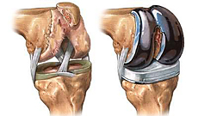
Where Will You Get
Your Knee Replaced?
Knee Joint
Replacement
Consumer Share of Surgery Cost | Price #1 $20,000 | Price #2 $25,000 | Price #3 $30,000

Slide 161
Where Will You Get
Your Knee Replaced?
Knee Joint
Replacement
Consumer Share of Surgery Cost | Price #1 $20,000 | Price #2 $25,000 | Price #3 $30,000
$1,000 Copayment: | $1,000 | $1,000 | $1,000
10% Coinsurance w/$2,000 OOP Max: | $2,000 | $2,000 | $2,000
$5,000 Deductible: | $5,000 | $5,000 | $5,000
✓
✓
✓

Slide 162
Where Will You Get
Your Knee Replaced?
Knee Joint
Replacement
Consumer Share of Surgery Cost | Price #1 $20,000 | Price #2 $25,000 | Price #3 $30,000
$1,000 Copayment: | $1,000 | $1,000 | $1,000
10% Coinsurance w/$2,000 OOP Max: | $2,000 | $2,000 | $2,000
$5,000 Deductible: | $5,000 | $5,000 | $5,000
Highest-Value: | $0 | $5,000 | $10,000
✓
✓
✓
✓

Slide 163
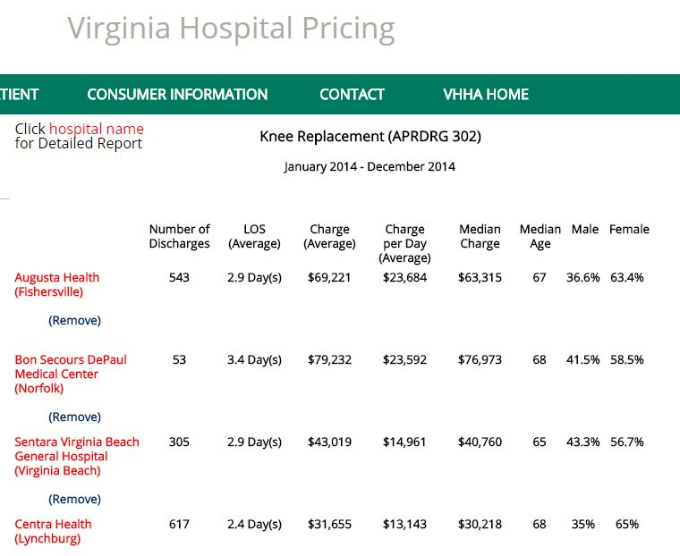
Will Transparency & Value-Based Benefits Result in Better Choices?

Slide 164
Current Transparency Efforts
Are Focused on Procedure Price
Payment for Procedure | dded
Provider 1:
$25,000
Provider 2:
$23,000
-8%

Slide 165
What Hidden Costs
Accompany the Lower Price?
Payment for Procedure | Payment and Rate of Complications
Provider 1:
$25,000 | $30,000 | 2%
Provider 2:
$23,000 | $30,000 | 10%
-8%

Slide 166
Total Spending May Be Higher With the “Lower Price” Provider
Payment for Procedure | Payment and Rate of Complications |  | Average Total Payment
Provider 1:
$25,000 | $30,000 | 2% | $25,600
Provider 2:
$23,000 | $30,000 | 10% | $26,000
-8% |  |  | +2%
Provider 2 has
a lower starting price,
but is more expensive
when lower quality
is factored in

Slide 167
Bundled/Warrantied Pmts Allow Comparing Apples to Apples
Payment for Procedure | Payment and Rate of Complications |  | Bundled/ Episode Payment
Provider 1:
 |  | 2% | $25,600
Provider 2:
 |  | 10% | $26,000
 |  |  | +2%
Bundled prices
show that
Provider 1 is the
higher-value
provider

Slide 168
Which ACO Will You Choose?
Coordinated Care for a Year
Consumer Share of ACO Membership | ACO #1 $10,000 | ACO #2 $12,000 | ACO #3 $15,000
$500 Monthly Premium | $6,000 | $6,000 | $6,000
Highest-Value: | $0 | $2,000 | $5,000
✓
✓

Slide 169
Not Just Benefit Design, But
Patient-Provider Relationships
Choosing & Using High-Quality Teams
Patients
Physicians,
Hospitals,
and Other
Providers
Lower Cost, Higher Quality Care

Slide 170
Today, Health Plans
All Too Often Get In the Way
Patients
Health Plan
Physicians,
Hospitals,
and Other
Providers

Slide 171
Today, Health Plans
All Too Often Get In the Way
Patients
Health Plan
Physicians,
Hospitals,
and Other
Providers
Providers aren’t paid to provide high-value
services
Providers have high administrative costs to deal with health plan controls

Slide 172
Today, Health Plans
All Too Often Get In the Way
Patients
Health Plan
Physicians,
Hospitals,
and Other
Providers
Health plans create
“networks” that may
not include full
teams of providers
Health plans create
“care management” services that may not coordinate with providers
Providers aren’t paid to provide high-value
services
Providers have high administrative costs to deal with health plan controls

Slide 173
Both Patients and Providers Lose
Patients
Health Plan
Physicians,
Hospitals,
and Other
Providers
Fail to receive
high-quality coordinated care
Struggle with excessive premiums,
cost-sharing, and deductibles
Health plans create
“networks” that may
not include full
teams of providers
Health plans create
“care management” services that may not coordinate with providers
Providers aren’t paid to provide high-value
services
Providers have high administrative costs to deal with health plan controls

Slide 174
Health Plans Should Support
Patient-Provider Relationships
Health
Plans
Implementation
Choosing & Using High-Quality Teams
Patients
Physicians,
Hospitals,
and Other
Providers
Lower Cost, Higher Quality Care
Patient Role
Choose and use a
primary care practice for preventive care, minor acute care, and care coordination
Choose and use a team of
specialists to manage serious health problems
when they arise
Provider Role
Help patients stay healthy and need less care
Provide coordinated care to achieve good outcomes for serious
health problems

Slide 175
Four Things Needed
For Win-Win-Win Solutions

Slide 176
Four Things Needed
For Win-Win-Win Solutions
Defining the Change in Care Delivery
  How can care be redesigned to improve quality and reduce costs?

Slide 177
How to Find Savings Opportunities? Ask Providers
“I have zero control over
utilization or studies ordered.
I don’t get paid for calling
a referring doctor and
telling him/her the imaging test
is worthless.”
Radiologist in Maine
“Patients often need to be in
extended care to receive antibiotics
because Medicare doesn’t pay for
home IV therapy. Patient stays
in the hospital for 3 days to justify
a nursing home/rehab stay.”
Orthopedist at AMA HOD Meeting
“I strongly suspect overutilization
of abdominal CT scans in the ER
and in the hospital; CT scans lead
to further CT scans to follow up
lung and adrenal nodules. The
hospital focuses on length of stay,
but never looks at appropriateness
of radiologic studies.”
Internist at AMA HOD Meeting
“I do many unnecessary
colonoscopies on young men.
Give every PCP an anuscope
to allow diagnosis of bleeding
hemorrhoids in the office.”
Gastroenterologist in Maine

Slide 178
Four Things Needed
For Win-Win-Win Solutions
Defining the Change in Care Delivery
  How can care be redesigned to improve quality and reduce costs?
Analyzing Expected Costs and Savings
  What will there be less of, and how much does that save?
  What will there be more of, and how much does that cost?
  Will the savings offset the costs on average?

Slide 179
A Critical Element is
Shared, Trusted Data
Healthcare Providers need to know the current utilization and costs for their patients and the likely impact of care changes to know whether the payment amount will cover the costs of delivering redesigned care to the patients
Purchasers/Payers needs to know the current utilization and costs to know whether the proposed payment amount is a better deal than they have today
Both sets of data have to match in order for providers and payers to agree on the new approach!

Slide 180
Four Things Needed
For Win-Win-Win Solutions
Defining the Change in Care Delivery
  How can care be redesigned to improve quality and reduce costs?
Analyzing Expected Costs and Savings
  What will there be less of, and how much does that save?
  What will there be more of, and how much does that cost?
  Will the savings offset the costs on average?
Designing a Payment System That Supports Change
  Flexibility to change the way care is delivered
  Accountability for costs and quality/outcomes related to care
  Adequate payment to cover lowest-achievable costs
  Protection for the provider from insurance risk

Slide 181
Four Things Needed
For Win-Win-Win Solutions
Defining the Change in Care Delivery
  How can care be redesigned to improve quality and reduce costs?
Analyzing Expected Costs and Savings
  What will there be less of, and how much does that save?
  What will there be more of, and how much does that cost?
  Will the savings offset the costs on average?
Designing a Payment System That Supports Change
  Flexibility to change the way care is delivered
  Accountability for costs and quality/outcomes related to care
  Adequate payment to cover lowest-achievable costs
  Protection for the provider from insurance risk
Implementing the Payment and Care Delivery Changes
  All payers need to change the payment system
  All providers need to accept the payments and change care delivery

Slide 182
What Most Communities Are Doing
Will Ultimately Harm Patients…
Medicare
& Medicaid
Consolidations
and Closures
Hospitals
Cost-Shifting
Through
Underpayment
Hospitals
Acquiring MDs
Inadequate
Payment
for
High-
Quality
Care
WIN-
LOSE
Specialists
Employers
Battle to Gain
Volume
Fragmented,
Expensive
Poor Quality
Care
PCPs
Inability to
Provide
Coverage
Patients
Inadequate #
of PCPs

Slide 183
…But Virginia Could Forge
Win-Win Solutions If It Wants To
Medicare
& Medicaid
Hospitals
Savings
for
Government
High Quality,
Financially
Viable
PCPs,
Specialists,
& Hospitals
WIN-
WIN-
WIN
Specialists
Savings
for
Employers
Employers
High Quality,
Affordable Care
PCPs
Patients

Slide 184





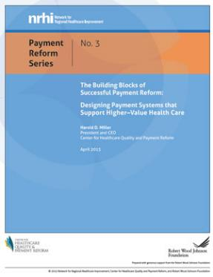

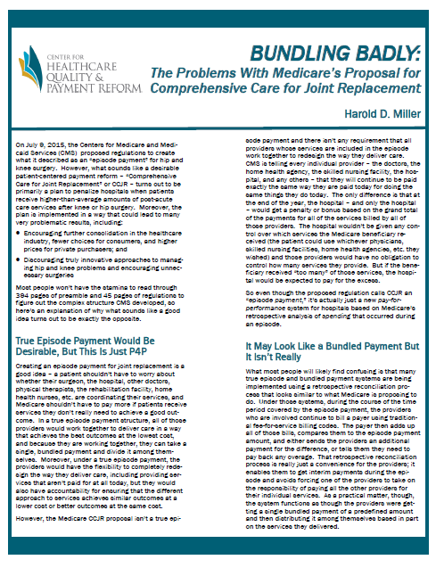
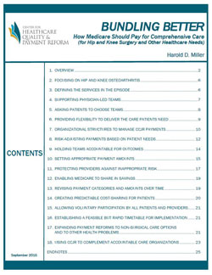
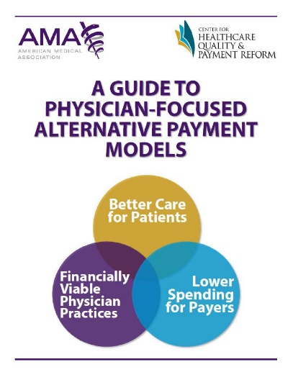
Learn More About Win-Win-Win
Payment and Delivery Reform
www.PaymentReform.org

Slide 185
For More Information:
Harold D. Miller
President and CEO
Center for Healthcare Quality and Payment Reform
Miller.Harold@GMail.com
(412) 803-3650
www.CHQPR.org
www.PaymentReform.org

